Slide 1
A Conversation on Lessons Learned from Marijuana Legalization in three States: Alaska, Oregon, and Washington
National Prevention Network Conference September 2016
Moderator: Renee Faber, DHHS – Behavioral Health, Nebraska
Panelists:
Tony Piper
Alaska
Department of Social and Health Services
Karen Girard
Oregon
Health Authority
Sarah Mariani
Washington
Department of Social and Health Services
Mary Segawa
Washington
Liquor and Cannabis Board

Slide 2
Overview of the Laws and Timelines

Slide 3
Washington Marijuana Milestones
Medical Use of Marijuana Act (I-692) – 1998
2011 - SB 5073 passed but partially vetoed
Legalization of marijuana for recreational use(I-502)
Passed November 2012
Retail stores opened July 2014. Retail licenses issued – 427 (8/31/16)
Medical integration - July 2016
 | Total sales* (shelf price) | Total tax obligation
FY 2015 | $259,785,729 | $ 64,946,432
FY 2016 | $972,729,675 | $185,786,493
FY 2017 (8/31/2016) | $246,274,506 | $ 47,101,325
Average daily sales WTD | $4,271,067

Slide 4
Oregon marijuana milestones
1998
Measure 67 establishes Oregon Medical Marijuana Act
2014
Measure 91 legalizes marijuana for recreational use
October 1, 2015
Limited retail sales of marijuana through dispensaries
October 2016
Begin retail marijuana store licensing
2013
HB 3460 allows medical marijuana dispensaries and establishes registry
August 2015
HB 3400 allows local control of marijuana sales
SB 460 allows early sales of non-medical marijuana through dispensaries
June 2016
Limited retail sales plus (included edibles)
December 31, 2016
Retail marijuana sales in medical marijuana dispensaries ends

Slide 5
The Path to Legalization of Commercial Marijuana in Alaska
2000 Citizen’s Initiative failed with 40.9%
2004 Initiative again failed but this time with 44%
2014 Initiative passed with 52%
2015 Marijuana Control Board established and regulations began development
2016 First Licenses approved and the first sale is expected by late fall.

Slide 6
Collecting and Interpreting Data

Slide 7
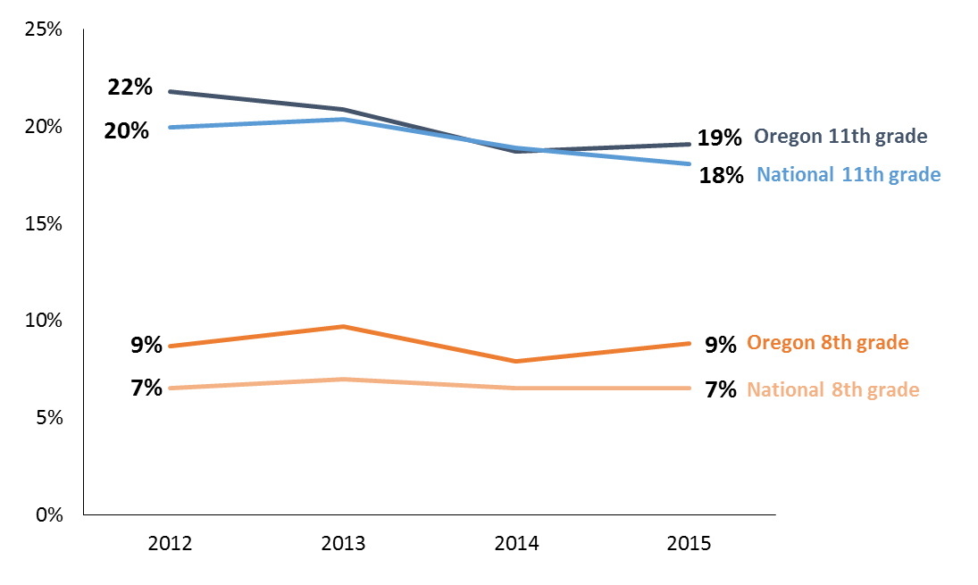
Oregon - Current marijuana use among youth over time, 2012-2015
Marijuana use has remained fairly stable over time in Oregon and nationally

Slide 8
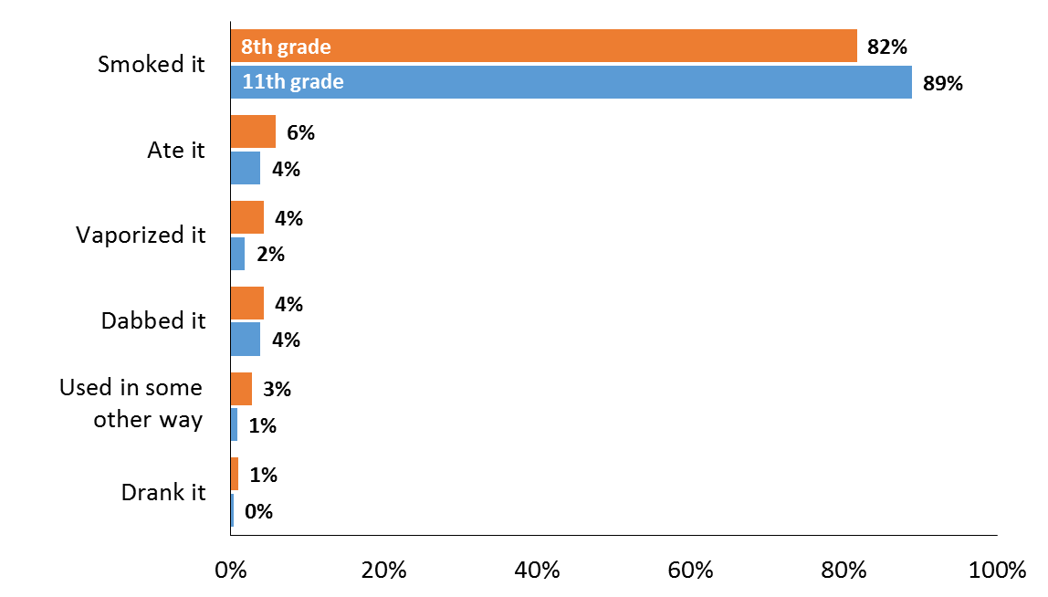
Usual method of marijuana use among youth current users, 2015
The vast majority of youth reported smoking as their usual method of use

Slide 9
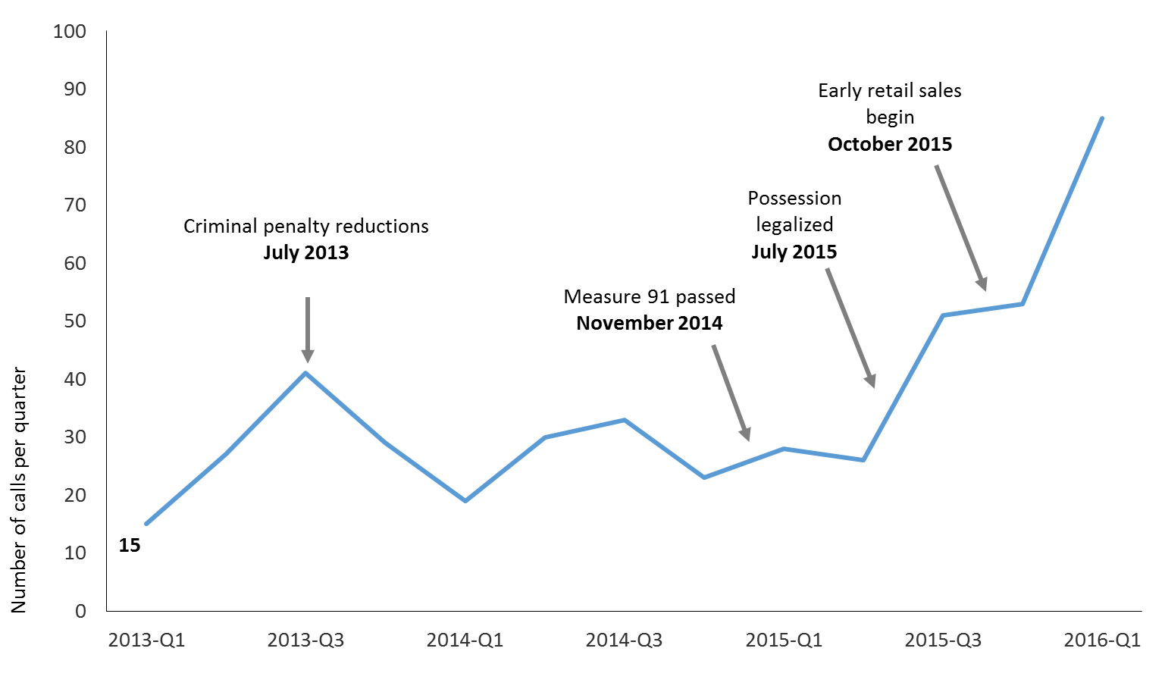
Marijuana-related calls to the Oregon Poison Center by quarter, 2013-2016
Marijuana-related calls have increased yearly since 2013; there were 158 calls in 2015

Slide 10
Percentage of High School Students Who Tried Marijuana Before
Age 13 Years,* by Sex,† Grade,
and Race/Ethnicity,†
2015
*For the first time
†M > F; A > H, A > W (Based on t-test analysis, p < 0.05.)
All Hispanic students are included in the Hispanic category. All other races are non-Hispanic.
Missing bar indicates fewer than 100 students in this subgroup.
Note: This graph contains weighted results.
Alaska (Recoded Race) - YRBS, 2015 - QN48

Slide 11
Percentage of High School Students Who Currently Used Marijuana,* by Sex, Grade,† and Race/Ethnicity,† 2015
*One or more times during the 30 days before the survey
†10th > 9th, 11th > 9th, 12th > 9th, 12th > 10th; A > W (Based on t-test analysis, p < 0.05.)
All Hispanic students are included in the Hispanic category. All other races are non-Hispanic.
Missing bar indicates fewer than 100 students in this subgroup.
Note: This graph contains weighted results.
Alaska (Recoded Race) - YRBS, 2015 - QN49

Slide 12
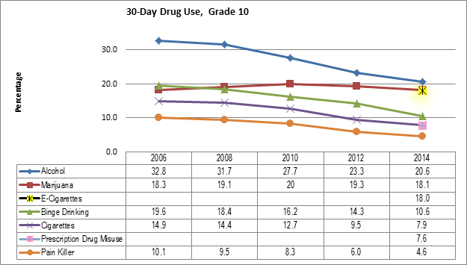
Drug Use Trends – Healthy Youth Survey

Slide 13
10th Grade Level of Marijuana Use
10 or More
Days 5.9%
6-9 Days 2.0%
3-5 Days 3.6%
1-2 Days 6.7%
Among 10th graders who used marijuana in the past 30 days, almost 1 in 3 used for
10 or more days
No Marijuana Use
81.9%
Source: Washington State Healthy Youth Survey – 2014.
13
Notes:
Among 10th graders, there has been a slight decline in marijuana use. The survey data reveals that, of the number of days within the past 30 days, the percentage of 10th graders reporting the marijuana use has also declined (e.g., for 10 or more days was 6.2% in 2010, 6.4% in 2012, and 5.9% in 2014).
Anecdotally, the increased availability of marijuana-laced edibles is of growing concern in public schools across Washington, which might account in part for the reduction in students smoking marijuana. There is need for more access data before this can be conclusive.
The larger concern is that 1 in 3 10th graders are using 10 or more days. Students who use marijuana often have difficulty learning, remembering, and problem-solving. These students are more likely to skip school, get lower grades and are less likely to graduate. (Source: Healthy Youth Survey [HYS] 2014 – Report of Results. Looking Glass Analytics, March 2015.)

Slide 14
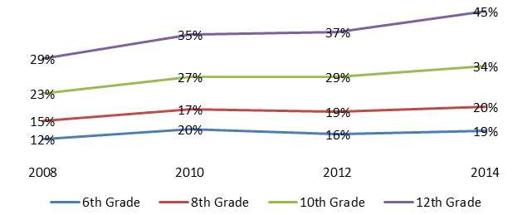
Percent who thought there was little or no risk of using marijuana regularly
Source: Healthy Youth Survey, 2008-2014

Slide 15
Perceived physical risk of regular marijuana use in 18-25 year olds
Source: Young Adult Survey, Jason R. Kilmer, Ph.D. & Mary E. Larimer, Ph. D., University of Washington

Slide 16
Perceived psychological/emotional/cognitive risk of regular marijuana use in 18-25 year olds
Source: Young Adult Survey, Jason R. Kilmer, Ph.D. & Mary E. Larimer, Ph. D., University of Washington

Slide 17
Past year recreational marijuana use in 18-25 year olds
Source: Young Adult Survey, Jason R. Kilmer, Ph.D. & Mary E. Larimer, Ph. D., University of Washington

Slide 18
Frequency of recreational cannabis use vs. perceived norms in 18-25 year olds
Key prevention message:
Non-users are not alone. May help boost self-efficacy to abstain.
Source: Underestimation of abstinence: see Kilmer et al. (2006); Overestimation of frequent use: see Wolfson (2000)
Notes:
When we ask people, "what does the typical 18-25 year old in Washington do related to marijuana," the right answer would be that they "never" use. BUT, only 2% of people get that right. Instead, you see the most common answers are they the typical person uses much more often.
Important because research shows that misperceptions of the prevalence of substance use are related to people's own actual use and even the consequences they experience.
The Wolfson article referenced at the bottom shows that the most significant misperceptions of marijuana use come from the most frequent users; Kilmer article shows that people misperceive the frequency of marijuana use of the "typical" person, and that this is, in fact, associated with their own use and consequences. So, there is a chance to correct misperceptions of prevalence.
Need to correct that misperception

Slide 19
Revenue

Slide 20
Products and Edibiles

Slide 21
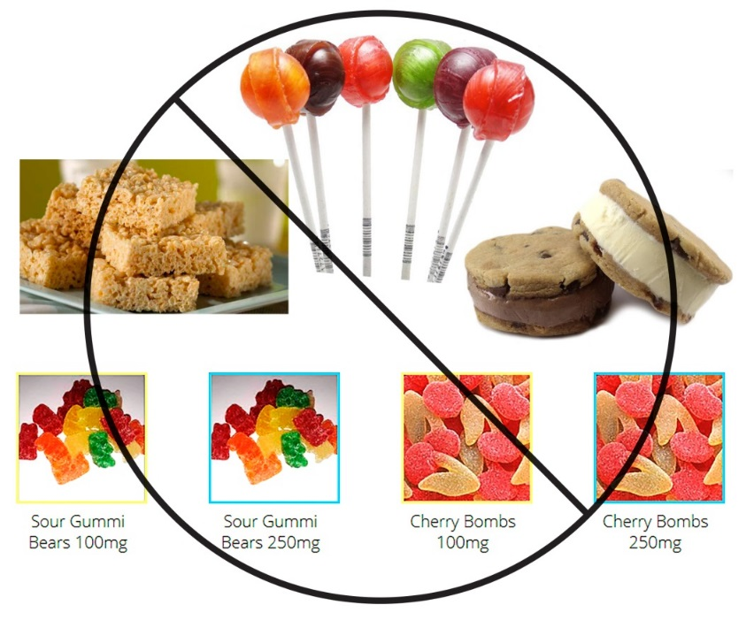
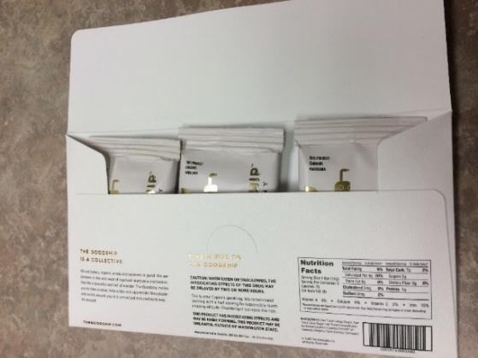
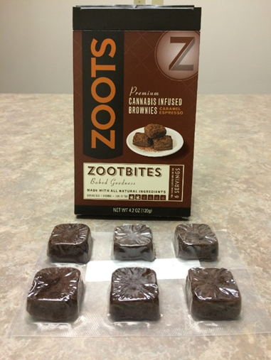
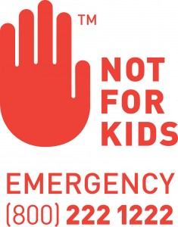
Edibles
Washington’s Universal symbol
Oregon’s Universal symbol

Slide 22
Marketing

Slide 23
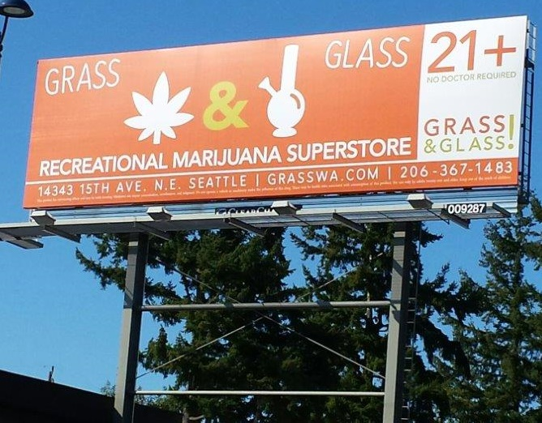
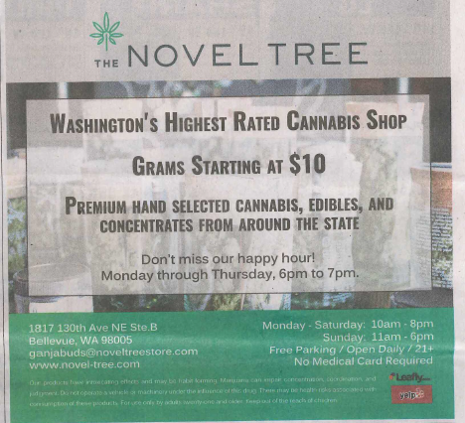
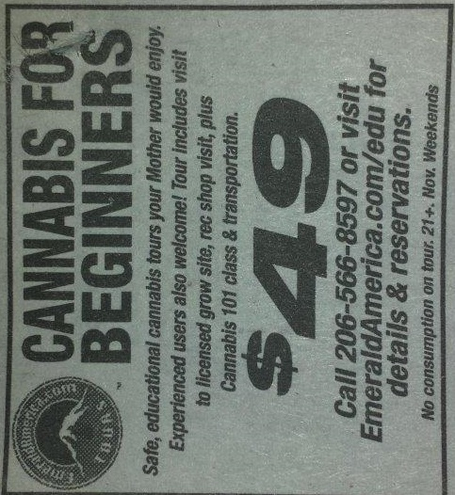
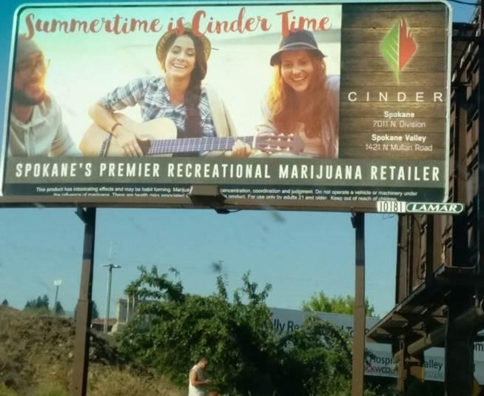

Slide 24
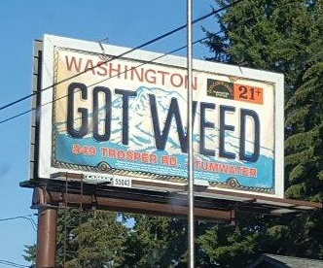
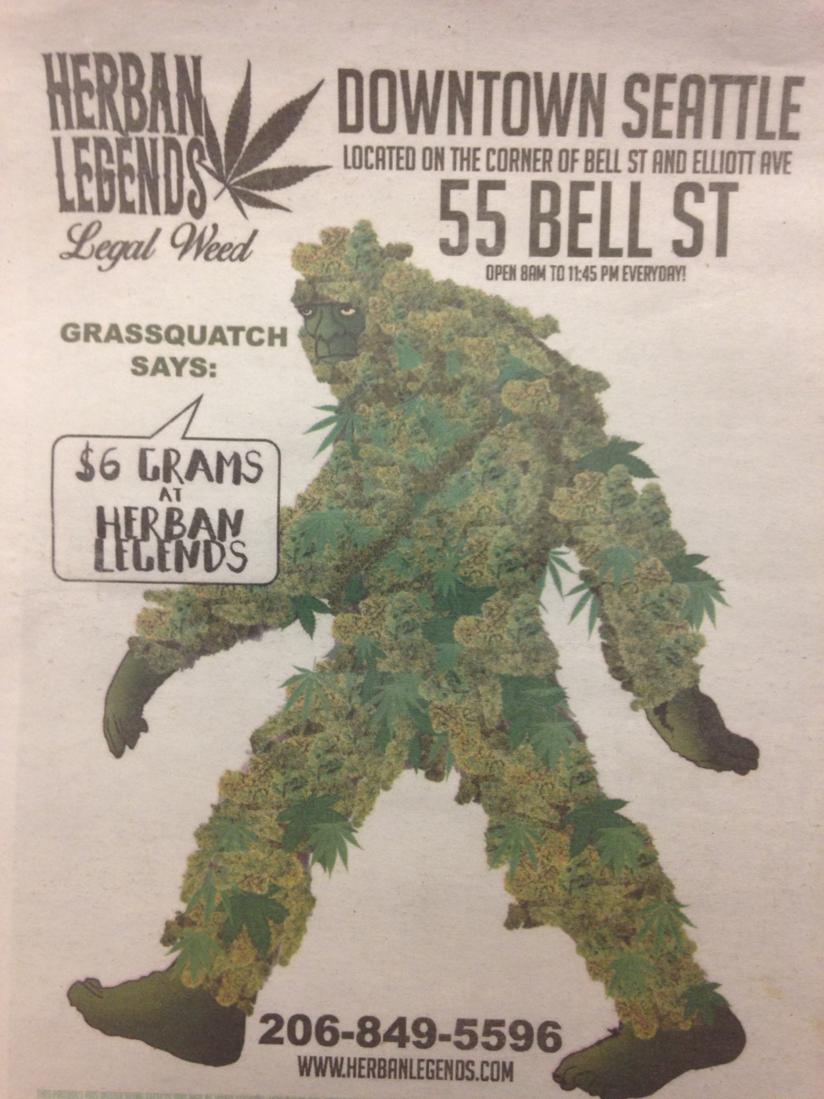

Slide 25
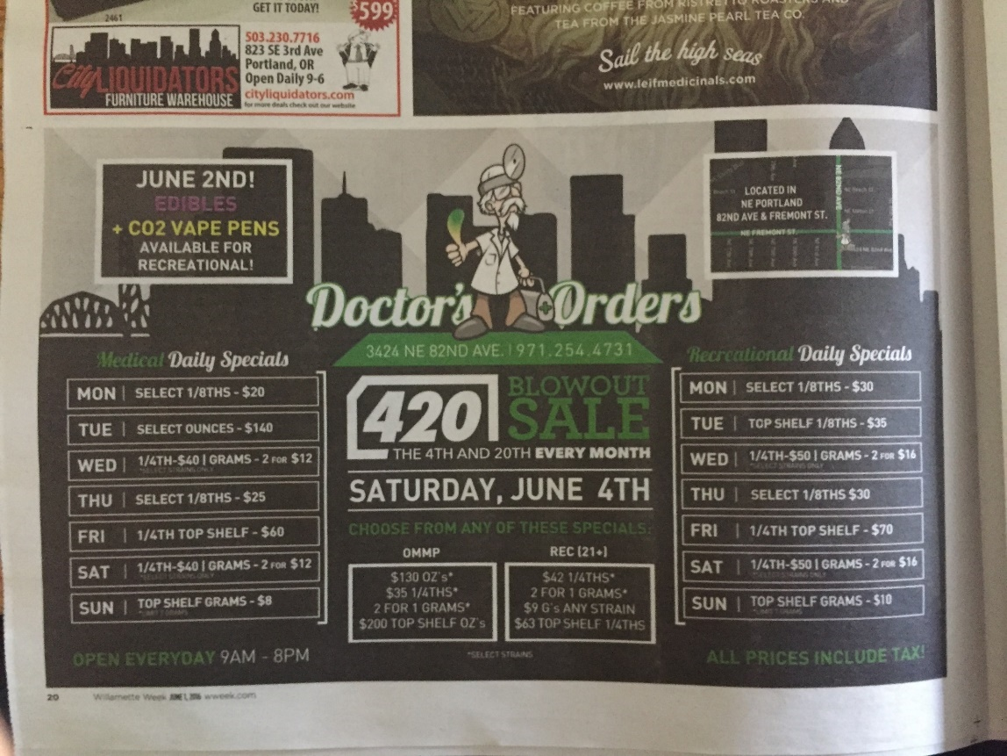
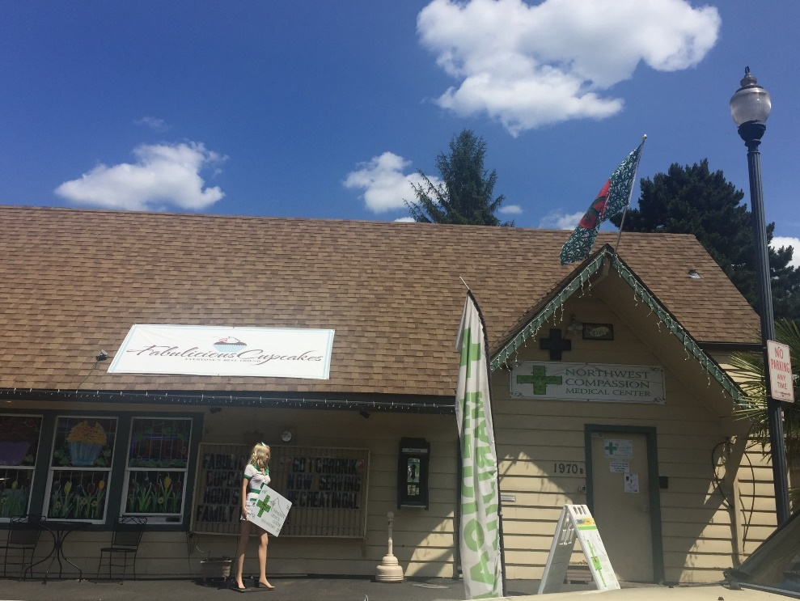

Slide 26
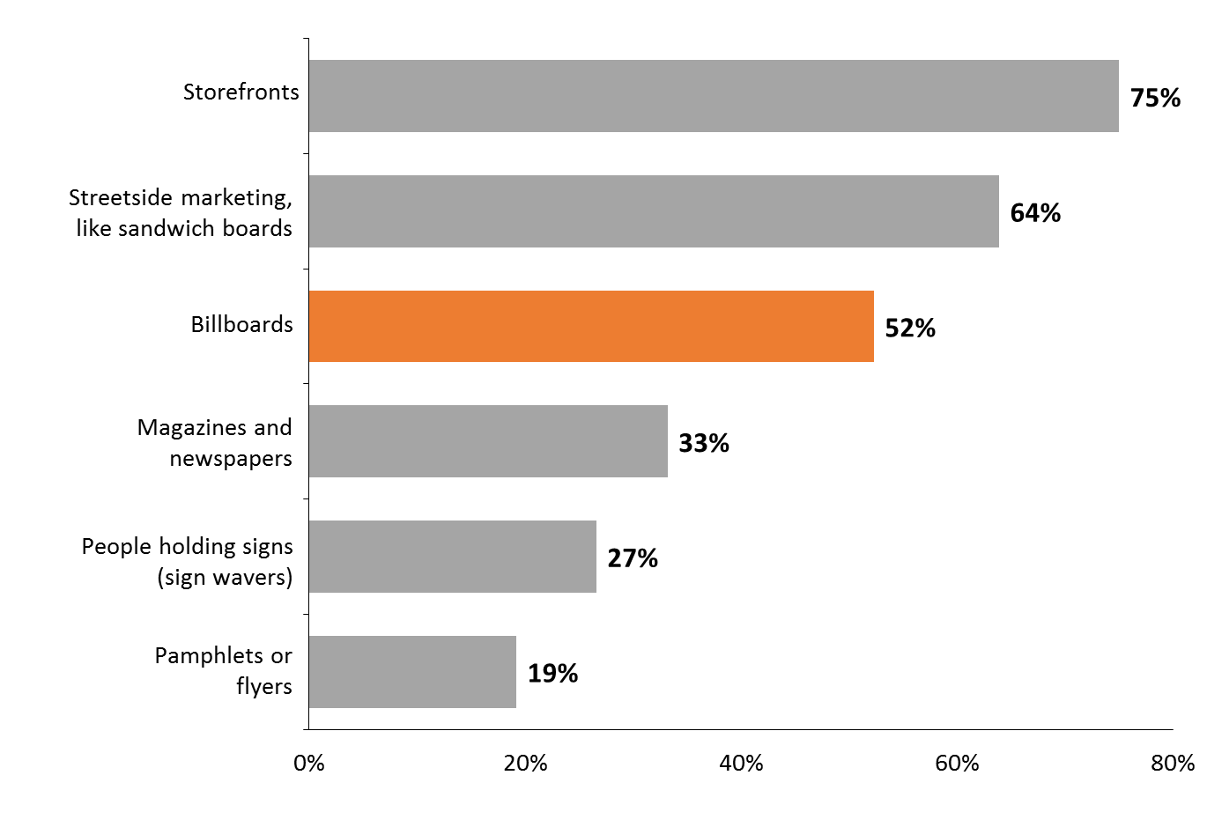
Type of marijuana advertising exposure among adults reporting seeing an ad in the past month, 2016
Three-in-four adults report seeing advertising on marijuana dispensary storefronts and about half of adults saw billboards for marijuana in the past month
Note: these data are preliminary

Slide 27
Regulations

Slide 28
Prevention’s Role

Slide 29
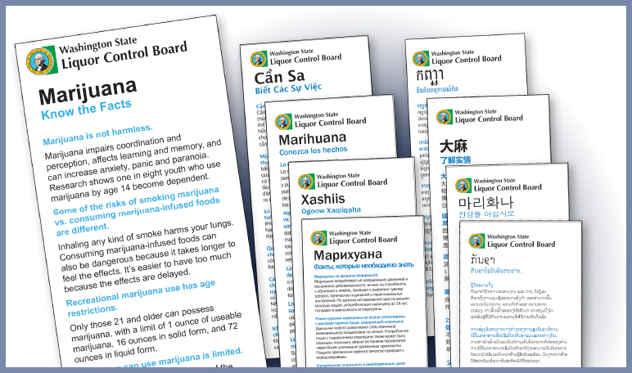
Education and Media Campaigns

Slide 31
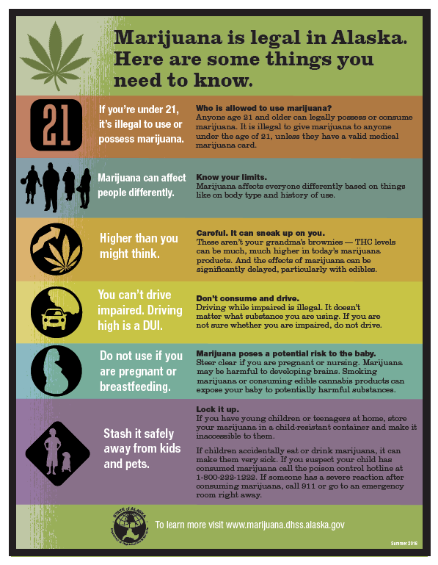

Slide 32
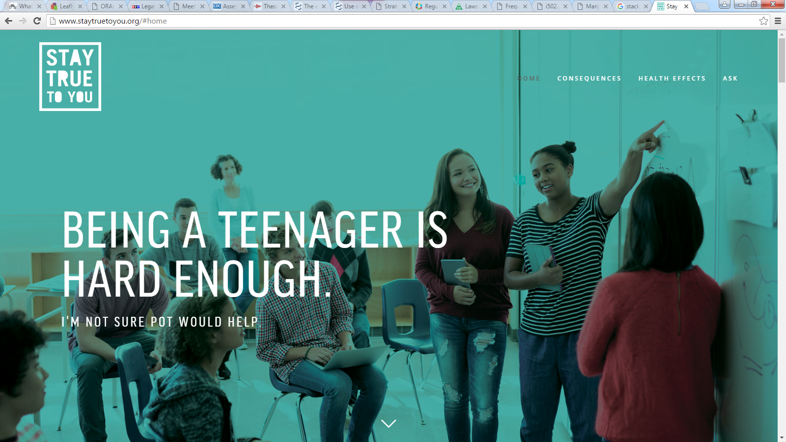
Youth marijuana prevention campaign

Slide 33
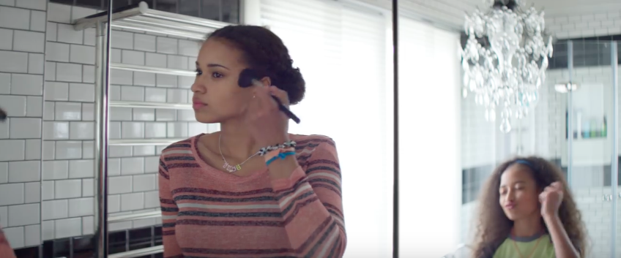
Whether you know it or not, people look up to you.

Slide 34
Lessons Learned and Going Foward

Slide 35
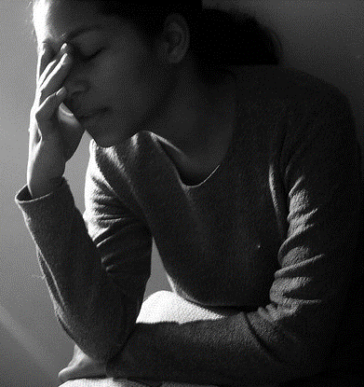
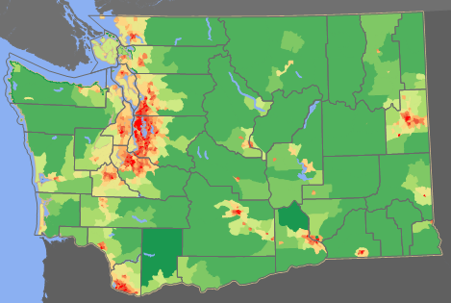
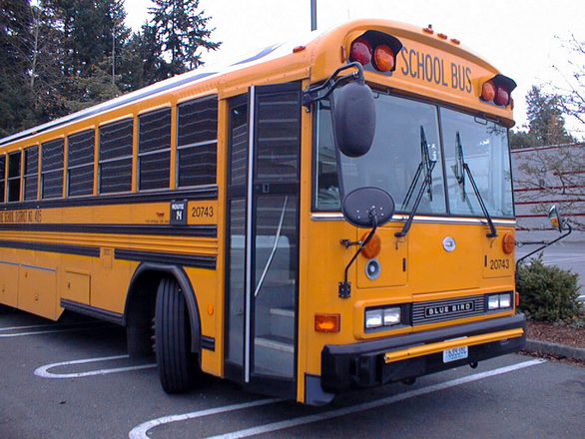
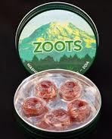
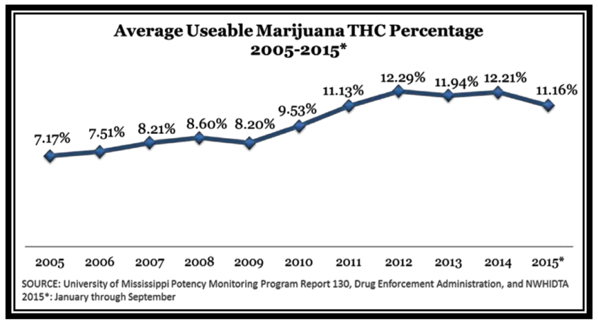
Lessons Learned
Notes:
Partnerships are critical
Surveillance on data is valuable
More research is needed that is specific and updated
Pay attention to edibles and vapors – “appealing to youth” and evolving products
Clearly communicate that marijuana is addictive
Major impact on schools
Potency matters
Law enforcement attitudes impact public norms
Tax and prices are important
Consider density, geography and advertisement placement (ads on next 2 pages)
Use what we know.

Slide 36
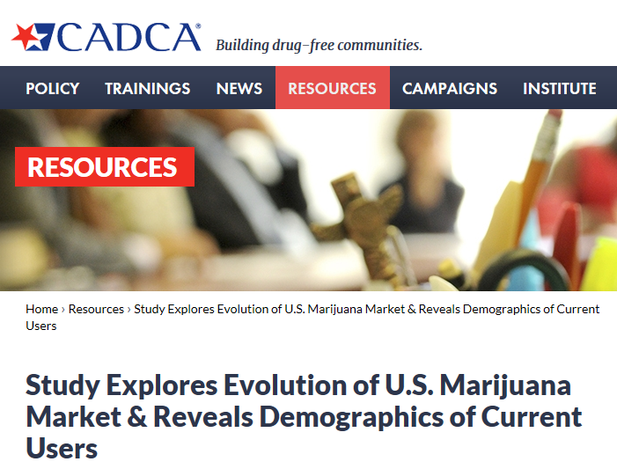
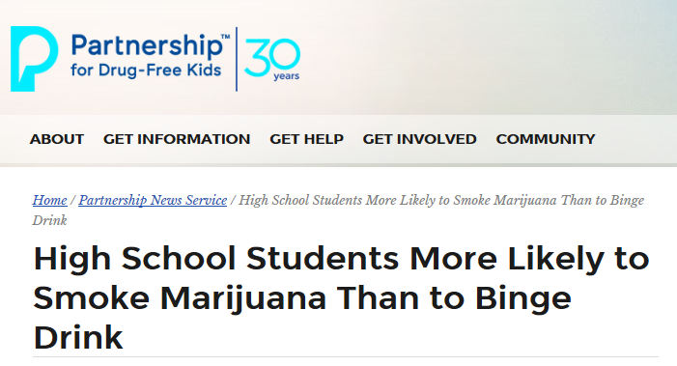
EXTRA! EXTRA! READ ALL ABOUT IT!

Slide 37
Resources
Athena Forum - http://www.theathenaforum.org/marijuana
Liquor and Cannabis Board – http://lcb.wa.gov
Healthy Youth Survey - www.AskHYS.net
Start Talking Now – www.starttalkingnow.org
University of Washington Alcohol and Drug Abuse Institute – www.LearnAboutMarijuanaWA.org
Alaska - http://dhss.alaska.gov/dph/Director/Pages/marijuana/facts.aspx
Oregon - https://public.health.oregon.gov/PreventionWellness/marijuana/Pages/index.aspx

Slide 38
Thank You!
Contact information
Tony Piper, ASAP Program Manager
Alaska Department of Social and Health Services, Division of Behavioral Health
907-264-0500
Tony.Piper@alaksa.gov
Karen Girard, Oregon and Health Promotion and Chronic Disease Prevention Section Manager
Oregon Health Authority
971-673-1046
Karen.E.Girard@state.or.us
Sarah Mariani, Behavioral Health Administrator
Washington State Department of Social and Health Services, Division of Behavioral Health and Recovery
360.725.3774
Sarah.Mariani@dshs.wa.gov
Mary Segawa, Public Health Education Liaison
Washington State Liquor and Cannabis Board
360.664.1771
Mary.Segawa@lcb.wa.gov

