Slide 1
Conducting CANS for
Let’s Draw the Line
Updated March 1, 2013
Notes:
Notes for Project Leaders:
This PowerPoint presentation is a tool for you to understand what CANS are and how to survey stores in your community.
Many slides have additional informational listed as “Notes for Project Leaders”.
Keep in mind that as you read through the notes and instruction of this Power Point, the notes will not appear as you present it as a “slide show”. We encourage you to make a copy of the notes for your reference and view the Power Point as a “slide show” prior to presenting, so that you can familiarize yourself with the transition of each slide.
We hope you will find this PowerPoint meets your training needs and is useful to your group and your community.

Slide 2
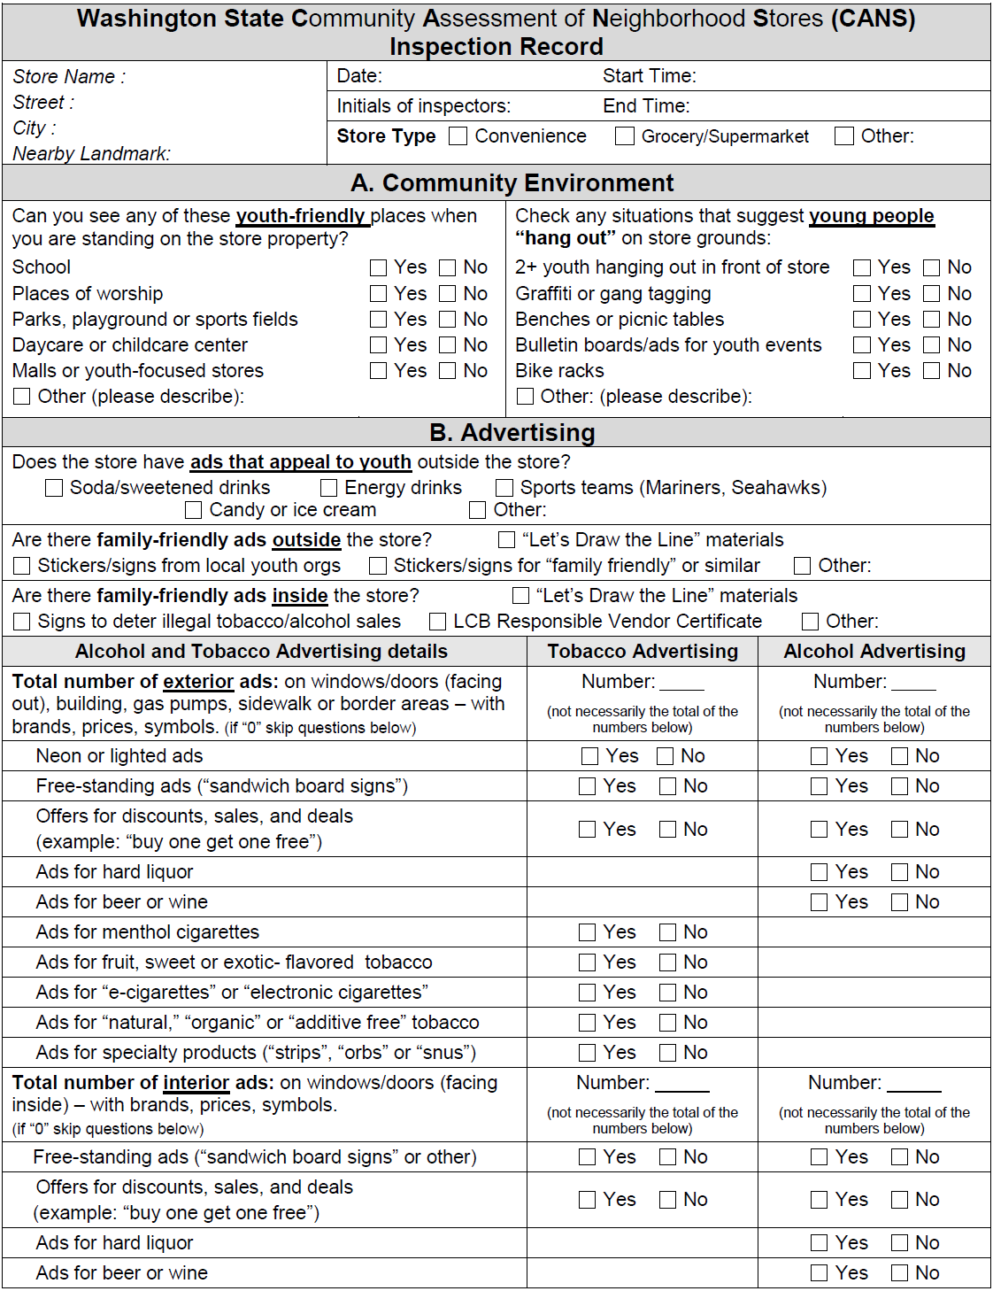
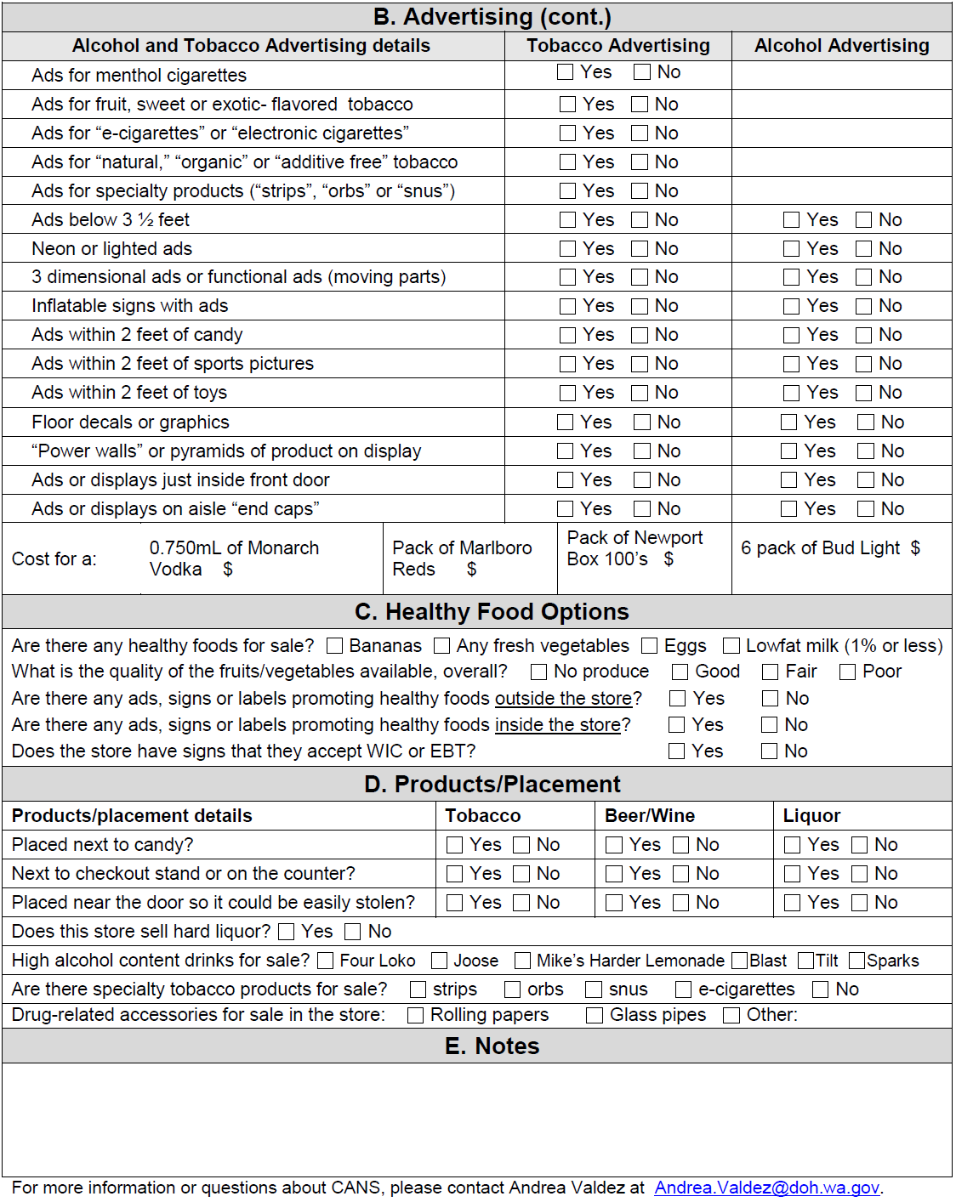
What is the CANS Survey???
Front
Back
Notes:
Notes for Project Leaders:
What is the CANS survey? It is a simple two-sided form to help you assess the stores in your community for how they sell and advertise alcohol, tobacco, and other products.

Slide 3
Survey Basics
A tool to assess your community stores
Looks at advertising, marketing, and products available
Can use results to make positive changes to individual stores
  Or can use to make changes to your whole community
Notes:
Notes for Project Leaders:
The results of the CANS survey can help you:
Work with individual store owners/managers to provide education on healthy retailing practices and not selling illegal products to youth.
Educate your community about the types of products for sale in your community, and how they are being marketed.
Educate decision-makers about steps they can make to help retail stores that sell tobacco and alcohol to do so in a healthier manner.

Slide 4
Why look at advertising?
Alcohol ads can encourage
youth to drink.
Findings from a 2006 study:
  Youth are exposed to an average of 23 alcohol ads each month.
  For each additional ad a young person saw,
  he or she drank 1% more.
Notes:
Notes for Project Leaders:
This information comes from a national study published in January 2006. The study concluded that greater exposure to alcohol advertising contributes to an increase in drinking among underage youth.
Another study found 7th graders who watched more TV programs with alcohol commercials were more likely to drink as 8th graders.
Other studies can be found here:
The Center on Alcohol Marketing and Youth website under factsheets.
www.camy.org/factsheets/sheets/Alcohol_Advertising_and_Youth.html

Slide 5
Why look at advertising?
Money spent on alcohol
ads is related to
underage drinking.
Additional findings from the study:
  The alcohol industry spends $6.80 per capita on alcohol advertising in a local market.
  For each additional dollar per capita spent on alcohol advertising , young people drank 3% more.
Notes:
Notes for Project Leaders:
This is some additional information from the January 2006 study.
Source: The Center on Alcohol Marketing and Youth website under factsheets.
www.camy.org/factsheets/sheets/Alcohol_Advertising_and_Youth.html

Slide 6
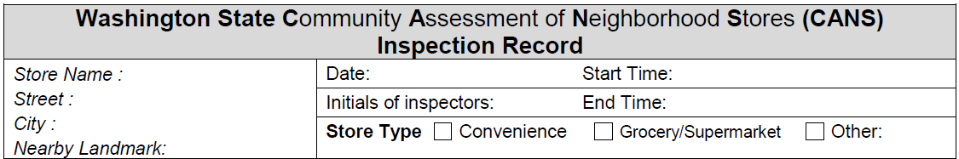
The first section of the form begins with general information about the store, such as Store Type, Store Name and Location.
Survey Introduction
Note: The entire front side of the cans Survey (with the exception of “interior ads” at the bottom of Section B) can be filled out while the group waits outside for the lead to give the okay to enter the store.
Notes:
Notes for Project Leaders: The first section of page 1 on the CANS Survey titled “Inspection Record” asks for general information regarding the store you are surveying.
When you conduct the CANS Surveys keep in mind that the front side of the CANS Survey (with the exception of “interior ads” at the bottom of Section B) can be filled out while the group waits outside for the lead to give the okay to enter the store.

Slide 7
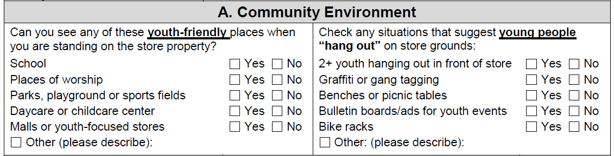
The Community Environment section of the survey asks that you do a quick assessment of what exists near the store and what is happening outside the store.
Section A: Community Environment
What schools are near by? Churches? Parks? Daycares?
Are there things in front of the store that suggest youth hang out there?
Notes:
Notes for Project Leaders - Section A “Community Environment” :
As you conduct this portion of the survey keep in mind that neighborhood stores are very important. They tend to be places where a lot of people go. So we want them to be as safe and clean as possible.
The Community Environment section of the survey asks that you do a quick assessment of what exists near the store and what is happening outside the stores.
Your group will look around to see if any of these are nearby:
Schools?
Churches or other places of worship?
Parks?
Daycares?
You’ll also look for things that suggest youth hang out at the store. Notes these items on the right-hand side of Section A.

Slide 8
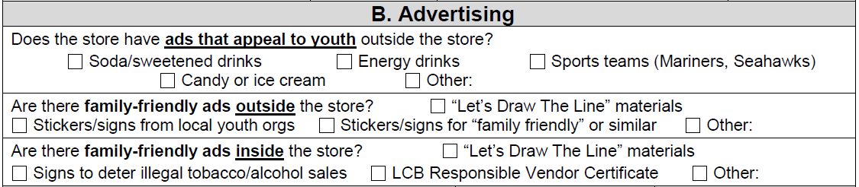
Section B of the Survey is separated into 3 parts:
Section B: Advertising
The first part measures ads that might appeal to youth, or show that the store is advertising to families and kids. This includes two kinds of ads:
General ads that appeal to youth (sports, candy, soda, etc.)
Family-friendly ads (Let’s Draw the Line, Responsible Vendor certificate, etc.)
You may find these ads either inside or outside the store.
Notes:
Notes for Project Leaders:
Section B of the survey is the longest section. It is all about advertising and it is made up of three parts.
The first part measures ads that might appeal to youth, or show that the store is advertising to families and kids. When looking at these ads, there is no need to count them. Just mark the box.
If you see an add that might appeal to youth or shows the store advertises to families that is not listed, be sure to check the “Other” box and describe the ad. For example, there is not a checkbox for when you see a flyer for a family-friendly event at a school or church (weekly bingo, spaghetti fundraiser, town hall meeting).

Slide 9
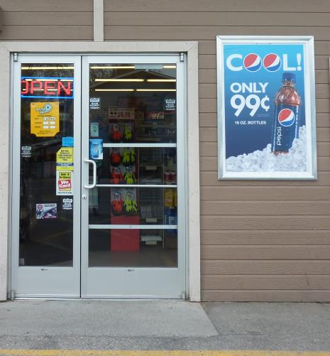
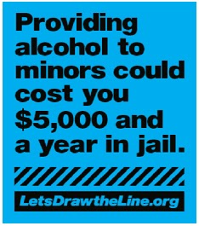
Examples of Youth and Family-Friendly Ads Outside the Store
Ad for soda/ sweetened drinks
“Let’s Draw the Line” window clings
Letsdrawtheline.org
Let’s Draw the Line 2012
Notes:
Notes for Project Leaders:
Here are some examples of youth and family-friends ads that you should be looking for.
The photo on the left shows an ad for Pepsi, a soda beverage. Other ads that appeal to youth that you might see outside the store are icee drinks (like Slurpees), energy drinks (like Five-hour Energy), ads with sports teams such as the Mariners and Seahawks, and candy or ice cream.
The photo on the right is an example of a “family-friendly” ad. This is a Let’s Draw the Line window cling which you could see inside or outside the store. Other examples of family-friendly ads include signs that warn of the consequences of illegally purchasing alcohol and tobacco, signs from the Liquor Control Board Responsible Vendor program.

Slide 10
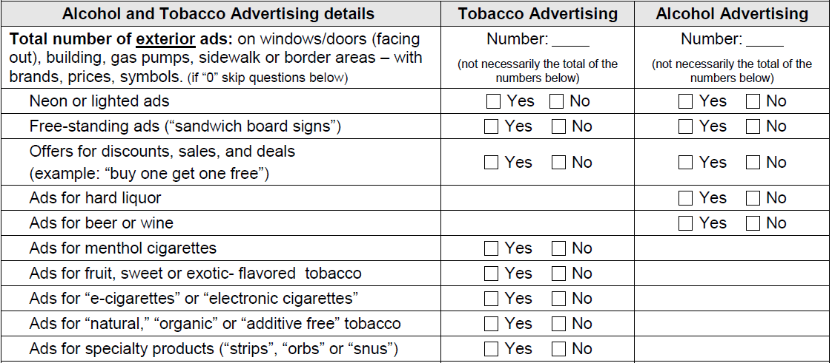
The second part of Section B looks at advertising outside the store:
Section B: Advertising
Does the store have alcohol and tobacco ads outside the store? Or ads inside the store that face outside? If yes… How many? What kinds?
Notes:
Notes for Project Leaders:
The next part of Section B asks about tobacco and alcohol ads on the outside of the store. When there are ads outside the store, be sure to mark yes box for that type of ad AND write down the total number of ads.

Slide 11
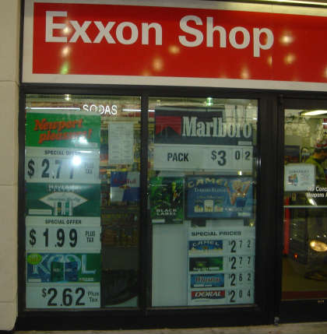
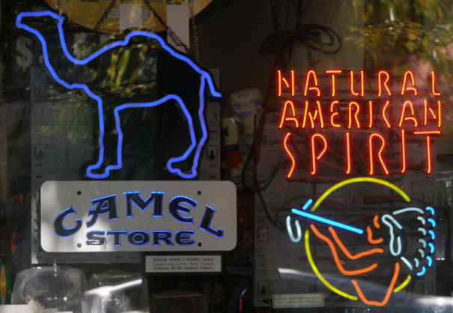
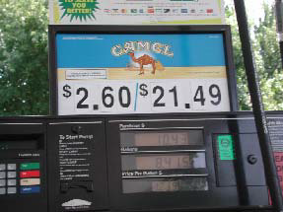
Examples of Ads Outside the Store
Ads inside the store facing out
Neon signs
Ribisil, NAAG, 2007.
Ads above gas pump
Whyquit.com
Ribisil, NAAG, 2007.
Notes:
Notes for Project Leaders:
Here are examples of the advertising you can see outside of a store. In the photo on the left, you can see signs advertising tobacco prices that are inside the store, but facing outside. This would be counted as an ad outside the store.
In the top right photo, there is an example of neon ads for tobacco, although these are commonly used for alcohol products as well. The bottom right photo shows a tobacco ad right above a gas pump. Ads outside the store are not always in obvious places, so be sure to do a thorough look around the store location.

Slide 12
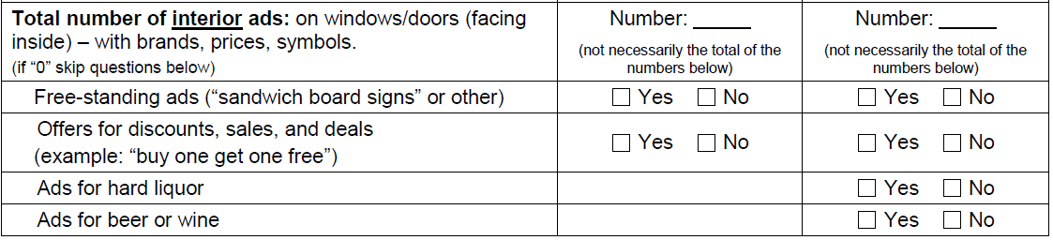
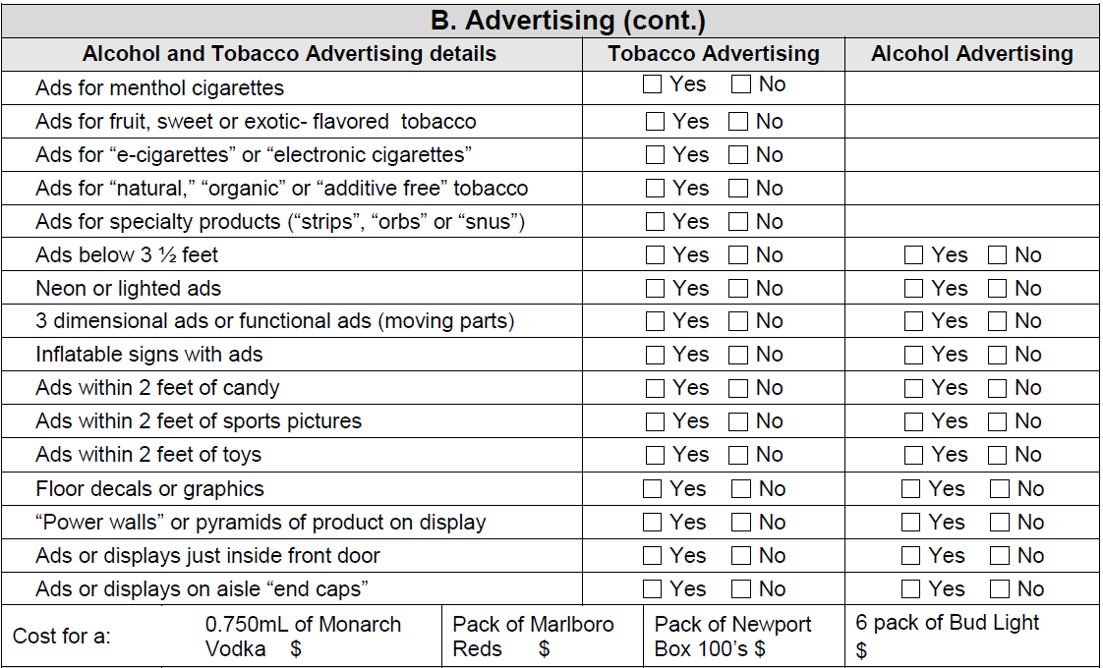
The third part of Section B looks at advertising inside the store.
Section B: Advertising
Notes:
Notes for Project Leaders:
The third and final part of Section B asks about tobacco and alcohol ads on the INSIDE of the store. Just like the outside ads, when there are ads inside the store, be sure to mark yes box for that type of ad AND write down the total number of ads.

Slide 13
Section B: Advertising (cont.)
What kinds of advertising promotions do you notice? (Giant foot balls, beach umbrellas?
Foot print or sticker ads on floor? Other decoration type ads?)
How are the products placed?
(Are products placed near candy or soda popular with youth? If so… how far? Are there any beer walls or pyramids? Are displays near entrance?)
How much are products that are popular with teens?
Notes:
Notes for Project Leaders:
When looking for indoor advertising, look carefully on walls, ceiling, doors and even floors.
Very little advertising happens by chance. So if an ad is within 3 ½ feet of the floor, it’s purpose is to market to youth, by placing its products at eye level of children.
Also notice the placement of products and displays:
Are they located next to other items popular among youth?
Close to entrance and exits of the store?
Are there footprint ads on the floor that lead you to appealing displays?
The last item in Section B asks for price info on some alcohol and tobacco items. Don’t forget to note this information as you are looking for the ads.

Slide 14
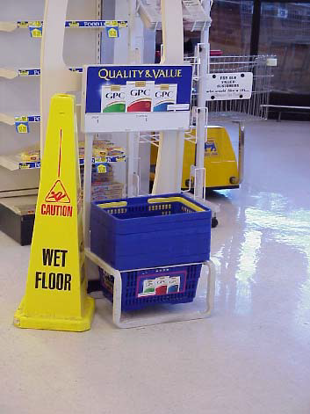
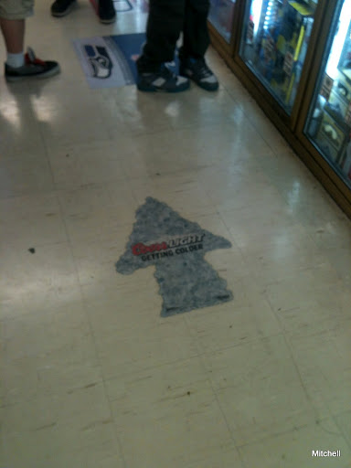
Examples of Ads Inside the Store
Functional ads
Floor decals
CANS Survey, 2012.
Ribisil, NAAG, 2007.
Notes:
Notes for Project Leaders:
These are some examples of non-traditional ads you might see inside of a store.
The photo on the left is an example of a floor decal or sticker advertising Coors Light, as well as directing customers to the location of this product in the store.
The photo on the right is an example of a functional ad, or an ad that is placed on something you would use in the store. These GPC brand cigarettes are advertised not only on the rack where shopping baskets are stored, but also on the side of the basket. This ad will be seen as customers walk throughout the store selecting items, and will be held right at the eye level of children.

Slide 15
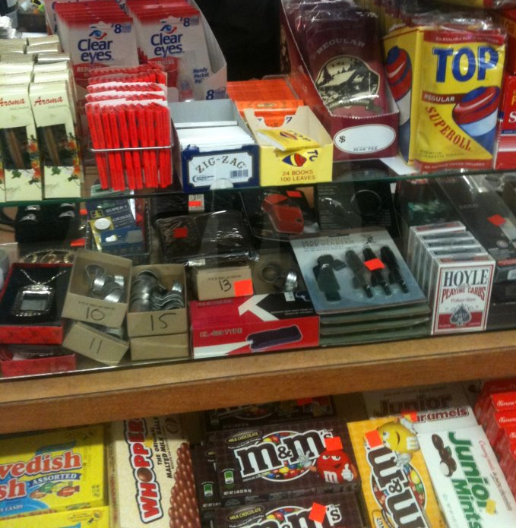
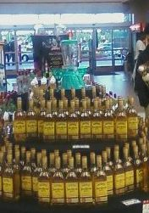
Examples of Ads Inside the Store
Ads near candy
Display pyramid
of liquor
Let’s Draw the Line, 2012
Let’s Draw the Line, 2012
Notes:
Notes for Project Leaders:
Here are some more examples of ads inside stores. The photo on the left shows tobacco products being sold near candy. The photo on the right shows an alcohol “pyramid”. When a large display rack of products is placed together, is become a large ad for the product.

Slide 16
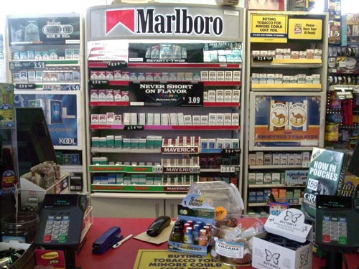
Examples of Ads Inside the Store
Power walls
Cayuga Community Health, 2012.
Notes:
Notes for Project Leaders:
One final example of an advertisement you might see in a store is a “power wall”. This is an example of a tobacco power wall. Much like the “pyramids” on the last slide, placing all of the product together in a certain way, especially with signs like this one for Marlboro, is an advertisement.
Tobacco and alcohol manufactures often require stores that sell their products to display them in this way because it increases sales.

Slide 17
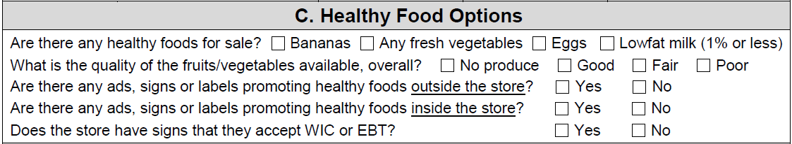
Section C asks you to check on the options for healthy foods at the store you are surveying.
Section C: Healthy Food Options
Are there any fresh fruits or vegetables for sale?
If so… What kinds? How much?
In many neighborhoods, people have to travel a long distance to find fresh, healthy food. So an important piece of this survey is to determine if stores in your community make fresh, healthy food available to people. Be sure to notice the different amounts of healthy options vs. unhealthy options.
Notes:
Notes for Project Leaders:
In many neighborhoods, people have to travel a long distance to find fresh, healthy food. So an important piece of this survey is to determine if stores in your community make fresh, healthy food available to people. The second section on Page 2 is a series of check boxes about healthy food choices.

Slide 18
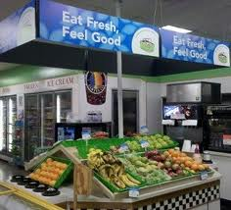
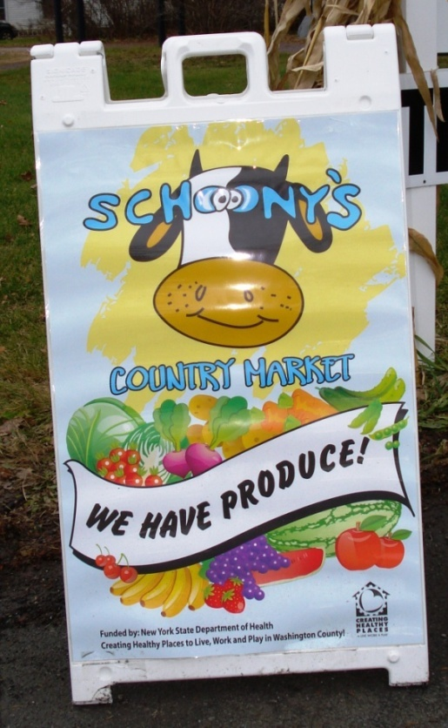
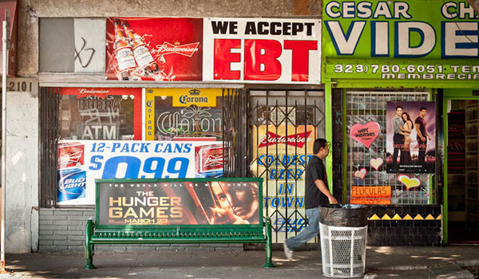
Examples of Healthy Food Ads
Inside the store
Outside the store
EBT signs
Houston Tomorrow, 2012.
New York State Department of Health
National Review Online, 2012
Notes:
Notes for Project Leaders:
These are a few examples of healthy food options. The photo on the top (“Eat Fresh, Feel Good”) and the photo on the right focus on fresh, healthy options available for purchase and are attractive for consumers.
The photo on the bottom left is an example of an advertisement for Electronic Benefits Transfer (EBT), a program which helps low-income people purchase groceries and other items. In this particular photo, you can see it is paired with an advertisement for Budweiser, and is surrounded by ads for other types of alcohol. In this case, you would check the box on the survey indicating that the store advertises acceptance of EBT, but you also may want to include something in the notes about how the EBT sign was placed. Other times, you may see ads and signs for EBT or WIC by themselves without other kinds of advertising nearby. You would also check the box in that case indicating the store advertises EBT/WIC. An important point here is that not all advertising is created equal.

Slide 19
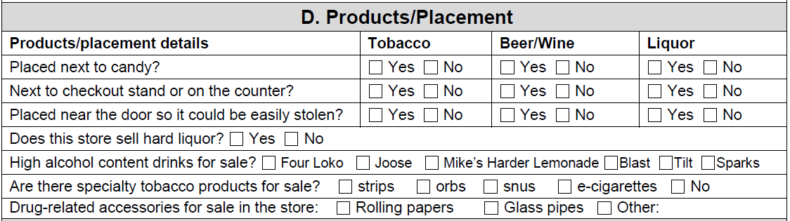
The last part of the survey asks you to look at where alcohol and tobacco products are placed and if certain specialty products are for sale.
Section D: Products and Placement
How are the products placed? (Are products placed near candy or soda popular with youth? Near door where they can be easily stolen?)
High Alcohol malt that are purposely manufactured & marketed with youth in mind…
Other drug related accessories? Rolling papers, pipes or other unhealthy drug related images?
Notes:
Note for Project Leaders:
For the questions in the Section D, determine if the stores sells any of the following high alcohol content products. These products are purposely manufactured & marketed with youth in mind:
FourLoko
Joose
Blast
Tilt
Sparks
If those products are for sale, check the appropriate YES box.

Slide 20
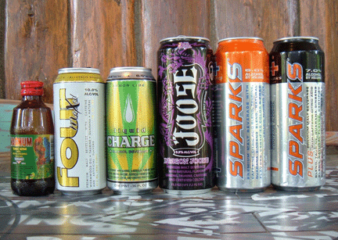
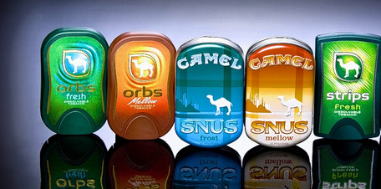
Examples of Specialty Products
High alcohol content beverages
Orbs, snus, and strips
AP, 2009.
Wall Street Journal, 2010.
Notes:
Note for Project Leaders:
Here are some examples of specialty alcohol and tobacco products. The top photo include Four Loko, Joose, and Sparks. The bottom photo includes tobacco orbs, snus, and strips. Both sets of products are often marketed to youth, using attractive packing and flavors.

Slide 21
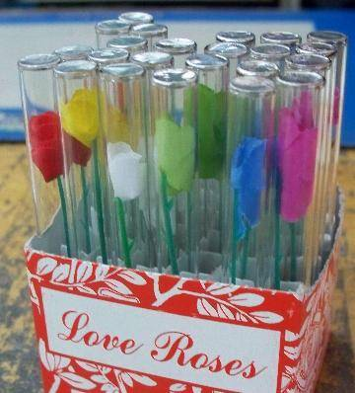
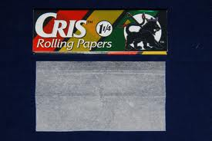
Examples of Drug-related Accessories
Small glass pipes
Rolling papers
Rollingpaperwarehouse.com
alcoholism.about.com
Notes:
Note for Project Leaders:
Look for other drug related accessories. Does the store sell rolling papers, pipes or other unhealthy drug related items?
Above are examples of drug-related accessories that you may not be familiar with. Here in Washington State, you may all be familiar with “traditional” glass pipes, which are often used to smoke marijuana. However, you may be less familiar with rolling papers, which are often marketed for tobacco use but are frequently used to roll marijuana joints. The photo on the left is an example of a rolling paper. These items are sometimes available on the counter at stores, within the reach of all customers.
Another drug-related accessory is small glass pipes, as seen in the photo on the right. These glass pipes are not the same as pipes for marijuana use, and are often marketed as another item – in this case, “love roses”. Love roses are a more common type of this drug-related accessory. These glass pipes are emptied of their contents and used to smoke crack cocaine. You may not see this type of item in your CANS surveying, but keep an eye out and be aware they exist.

Slide 22
Section E: Notes
This section is for your team to document any findings you may have discovered as you were surveying the store.
Examples might include advertising
that targets youth, items that support binge drinking sold near alcohol products, and any new products
available for sale.
Notes:
Notes for Project Leaders:
This section is for your team to document photos that were taken at each store as well as any other findings you may have discovered as you were surveying the store. This may be done at the time of the visit or when you meet back with the rest of your group to debrief your experience.

Slide 23
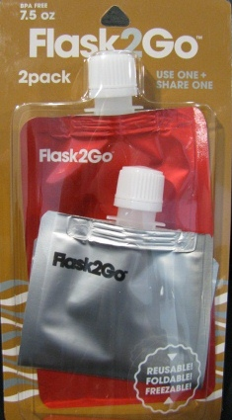
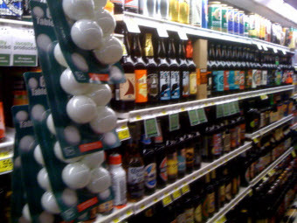
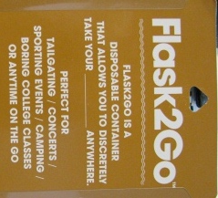
Examples of items not in the survey, but you may want to note
Products that help to
hide alcohol in plain site.
Drinking games and accessories (beer pong, funnels, etc.)
Consumerist, 2010.
Let’s Draw the Line, 2013.
Notes:
Notes for Project Leaders:
Here are a couple of examples of items not included in the survey, but you may want to include in your notes.
On the left is a photo showing ping pong balls for sale next to the beer. These items are being placed together because ping pong balls are used in the game “beer pong”, which is a binge drinking game.
The photo on the right shows a new product for sale. These pouches are re-fillable to hold liquor, and are easily hid by youth in public places. Keeping an eye out for new products or items that strike you as unusual are a great thing to record in your notes. Other people around Washington may be seeing similar items.

Slide 24
Preparing to Conduct the CANS Survey
Organize Survey Teams of no more than 4 members per group (per store) that will go to stores and implement the CANS Surveys.
Using the list provided to your group, decide which stores your team will survey and what day/time will work best.
Before you approach the store:
  Decide as a group who will talk to the clerk (youth leader or adult) first, and what they will say.
  Assign duties to the “Survey Group.”
  Be sure to bring a copy of the CANS Survey & any other “Lets Draw the Line” resource materials you have to leave with the store clerk.
Notes:
Notes for Project Leaders:
The next few slides are instructions on preparing your Survey Teams and tips on conducting CANS.
Instruction: When meeting with your CANS Survey Team:
Organize Survey Teams of no more than 4 members per group (per store) that will go to stores and implement the CANS Surveys.
Decide which stores your team will survey and what day/time will work best.
Before you approach the store:
Decide as a group who will talk to the clerk (youth leader or adult) first, and what they will say.
Assign duties to the remaining group conducting the survey.
Be sure to bring a blank copy of the CANS Survey and any other resource materials you have to leave with the store clerk for their reference.

Slide 25
CANS Survey Team Assigned Duties
Survey Team Assigned Duties:
  One Adult or Youth Leader to enter the store and speak to the store clerk.
  One Person to fill out CANS Survey.
  One Person to count alcohol & tobacco ads. (Others in the group can help, but have one person be in charge of making sure ads are only counted once.)
Notes:
Notes for Project Leaders:
Duties should be assigned to your group:
One Adult or Youth Leader to enter the store and speak to the store clerk.
One Person to fill out CANS Survey.
One Person to count alcohol & tobacco ads.

Slide 26
Conducting the CANS Survey…
Have Adult or Youth Leader enter store (alone) and introduce self & purpose of the CANS Survey. In the meantime, the rest of the group can begin their duties on front side of the CANS survey.
When Adult or Youth Leader give the “OKAY” the remaining Survey Group may enter the store and finish conducting the remaining portions of the survey.
Notes:
Notes for Project Leaders:
When conducting the CANS Survey:
1. Have adult or youth leader enter store (alone) and introduce self & purpose of the CANS Survey. In the meantime, the rest of the group can begin their duties on Section A and the exterior/outside portions Section B on the CANS.
2. When Adult or Youth Leader gives okay… The Survey Group may enter the store and finish conducting the remaining portions of the survey (REMEMBER to seek permission before taking photos on the inside of the store.)

Slide 27
Conducting the CANS Survey (cont.)
Thank store clerk. If you would like to, leave them with information about the Let’s Draw the Line campaign or other resources you may want to share.
Scan copies of all completed CANS surveys and send to: LDTL2013@dshs.gov
Notes:
Notes for Project Leaders:
Thank store clerk and leave them with information about “Lets Draw the Line” campaign and any other resources and information on the steps they can take to reduce alcohol.

Slide 28
Taking Photos
You may want to take photos of the advertising and marketing you see in the stores you visit. However, photos from your CANS work is not a reporting requirement of Let’s Draw the Line 2013.
Many stores only allow photos to be taken outside of store. Be sure to ask the employee/manager/owner the store policy is before taking photos.
Notes:
Notes for Project Leaders:
Photos from your CANS work is not a requirement of Let’s Draw the Line 2013. However, photos from your CANS work would fit well with the Our Town Presentation that will feature a summary of your CANS work.
Photos can also be very helpful in showing how the stores in your community sell and market alcohol and tobacco products.

Slide 29
Taking Photos
If you have taken some great photos and would like to share them please post them on the Let’s Draw the Line Facebook page.
  www.facebook.com/letsdrawtheline/photos

Slide 30
Resources
Let’s Draw the Line 2013
  www.starttalkingnow.org/our-efforts/free-materialsresources/lets-draw-line-between-youth-and-alcohol
Washington Responsible Vendor information
www.liq.wa.gov/licensing/responsible-vendor-program

Slide 31
Resources (cont.)
Center on Alcohol Marketing and Youth
  www.camy.org
Alcohol Justice
  www.alcoholjustice.org
CounterTobacco
  www.countertobacco.org

Slide 32
Questions?
For general questions about Let’s Draw the Line 2013, including reporting requirements, e-mail LDTL2013@dshs.wa.gov
or call Ray Horodowicz at (360) 725-1528

Slide 33
More Questions?
Do you need any assistance with the CANS survey or working with retailers and/or your community?
Contact Andrea Valdez, Washington Office of Healthy Communities
  Andrea.valdez@doh.wa.gov

