Slide 1
Preventing Underage Drinking Among College Students
Environmental Scan
September 2017

Slide 2
Even though rates of alcohol consumption among college students have declined over the past 25 years, most college students still drink¹
WA DSHS and GMMB want to understand creative and strategic approaches of alcohol consumption prevention campaigns targeted at underage college students
We also examined campaigns addressing other issues relevant to college students such as mental health and sexual assault
Findings will be used to identify best practices for campaigns that prevent alcohol consumption by underage college students
What we’re doing and why
Source: Journal of Studies on Alcohol and Drugs, 2017

Slide 3
State and national campaigns targeting college students with messages about underage and binge drinking
Student-created campaigns for individual universities
The takeaways and best practices reported here are qualitative in nature and based on analysis of a limited number of campaigns
Some—but likely not all—of the public health campaigns assessed were informed by research and measured results. The campaign summaries in this deck include mention of research and/or results when this could be ascertained via publicly-available information.
What we examined

Slide 4
Binge drinking prevention has become a more common focus than general alcohol prevention
While facts and statistics are a sobering reminder of alcohol’s consequences, they can come off as impersonal and thus less relevant when used alone
Social norms approaches are a less common and potentially less compelling approach given the prevalence of alcohol consumption among college students
Although severe risk messaging is common and powerful, personal and relatable consequences such as academic performance or negative reputation have the potential to also be impactful
Two call to actions dominate campaigns: directives (“don’t drink”) and invitations (“think about it”). Approaches that respect individuals’ abilities to make the best decision for themselves may resonate more with this college-age audience
Language used in campaigns is largely inconsistent with how college students talk about alcohol consumption. And more broadly, campaigns tend to talk at students, not with them
College students aren’t the only target of underage drinking campaigns. Some reach college students by targeting the adults in their lives (parents, professors, etc.)
Key Takeaways

Slide 5
Consider approaches that warn against binge drinking vs. overall prevention: the prevalence of alcohol consumption and “almost legal” sensibility means a general prevention message may resonate less
If outlining risks and statistics, consider ways to bring them to life and make them feel more personal for the audience
When speaking to consequences, consider those that directly impact college students’ everyday goals and desires, such as academic performance or maintaining one’s reputation
College students are adults who are gaining independence and making decisions on their own. Approaches should be relevant to this unique stage of life. Messages that respect their ability to make decisions for themselves, rather than telling them what to do, may be effective
College students are motivated to do what’s right. Messages that encourage them to intervene on behalf of their friends may be effective
Continue reaching parents and trusted adults, as their voices are influential in preventing underage drinking
Tone and language matter. Speak to them like a trusted peer and avoid talking down to them like an authority
Creative considerations moving forward

Slide 6
Underage Drinking Campaigns

Slide 7
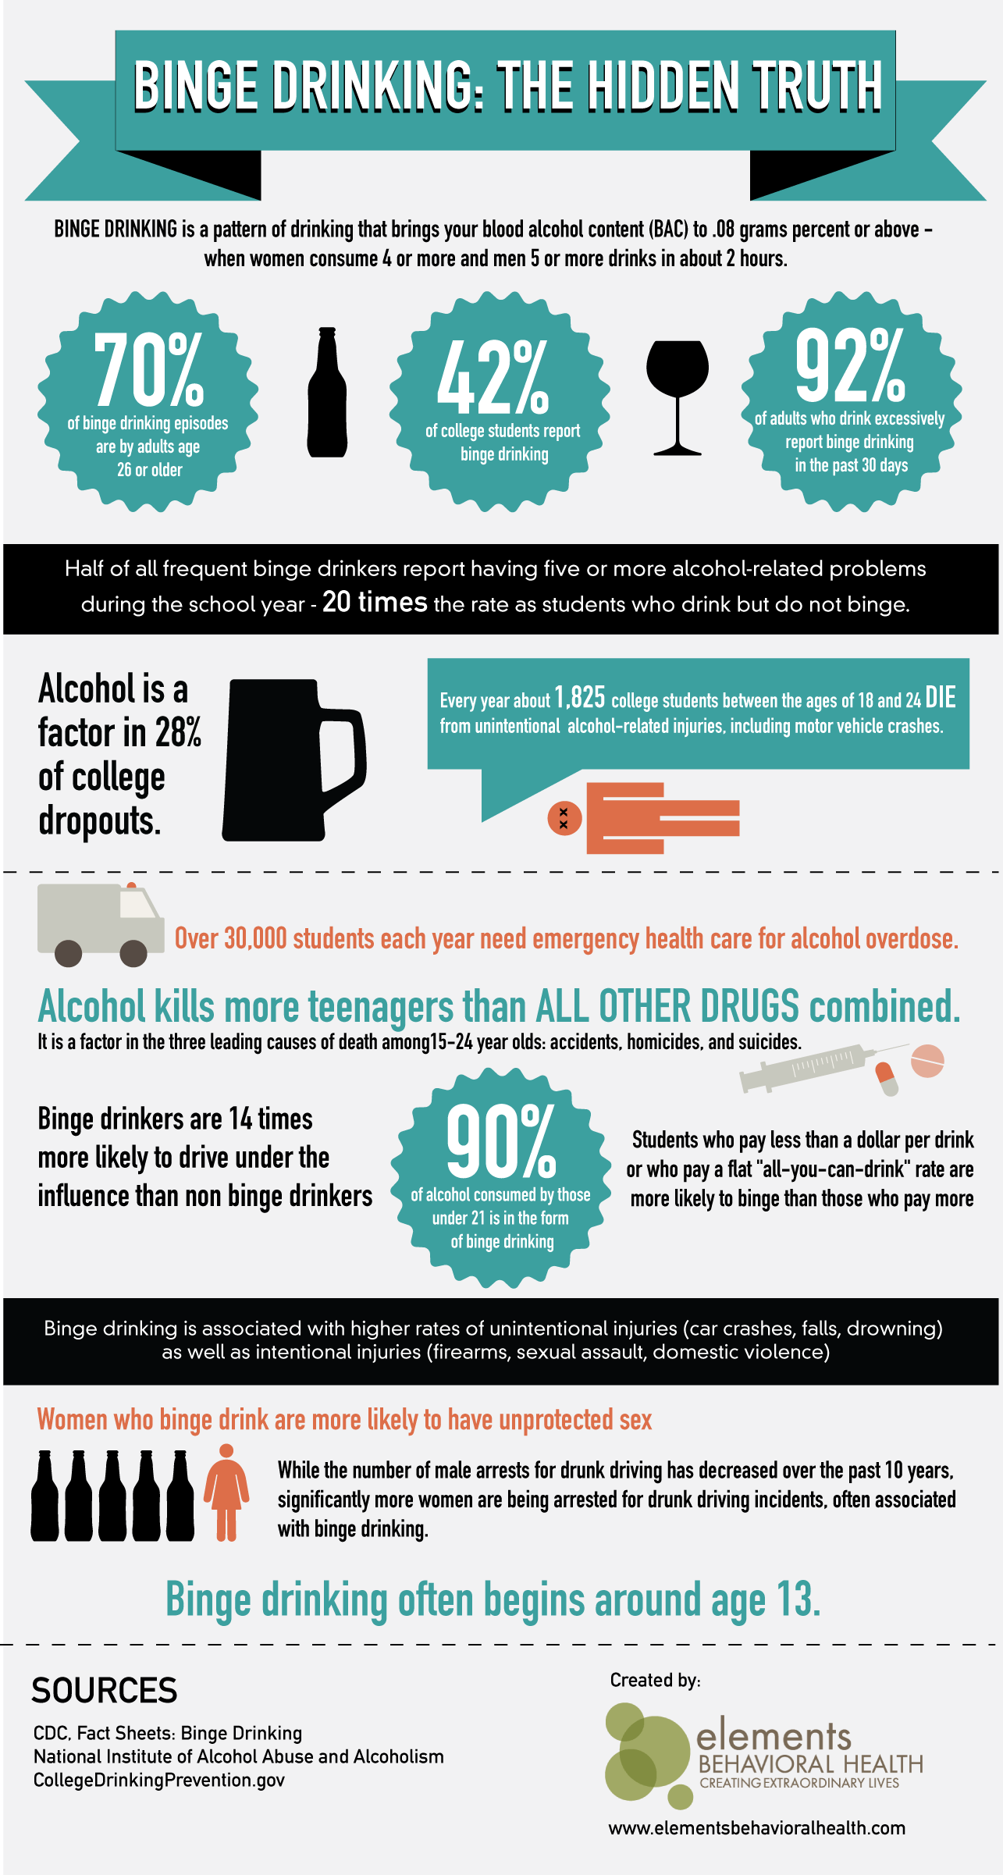
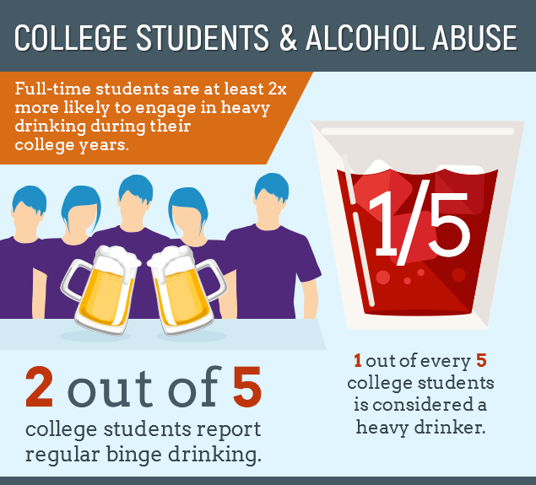
College Drinking: Changing the Culture
(2012)
Client:
The National Institute on Alcohol Abuse and Alcoholism
Campaign Goal:
Raise awareness of the dangers of binge drinking on college campuses
Research:
NIAAA has adapted campaigns several times since its inception in 2002 based on somewhat regular research updates. The most recent research confirms the benefits of a hyper-targeted and multimedia approach, and the limitations of social norms only strategy.
Key Message:
Alcohol consumption is a problem among college students. Here’s what you need to get informed about alcohol abuse and binge drinking.
Channels:
Partnerships with college presidents
Website
Creative Approach:
Combines surprising facts and messages about consequences
Offers a tool for colleges to identify effective interventions
Results:
Has been successful in raising awareness and reducing heavy binge drinking, but results have been more short-term

Slide 8
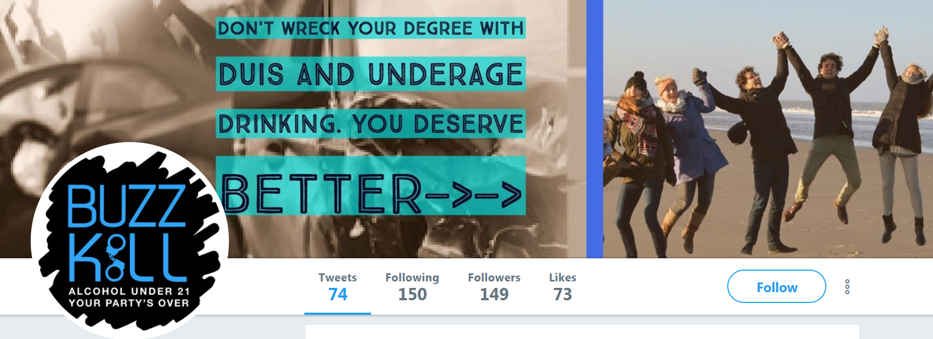
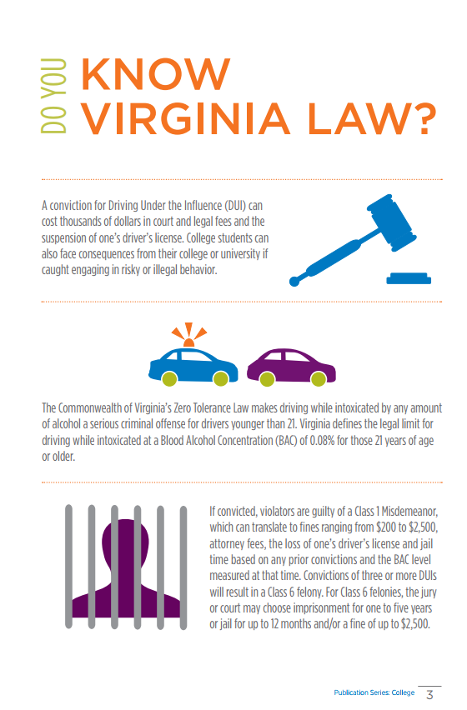
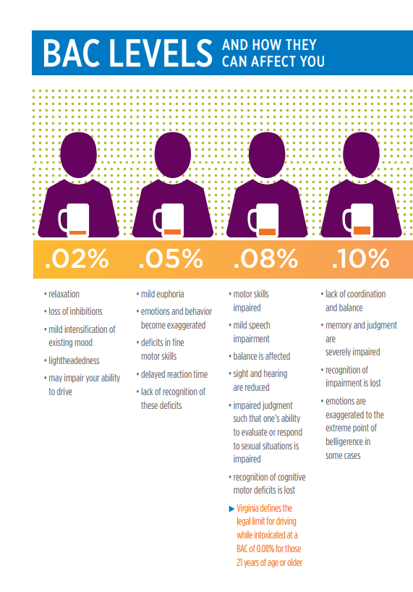
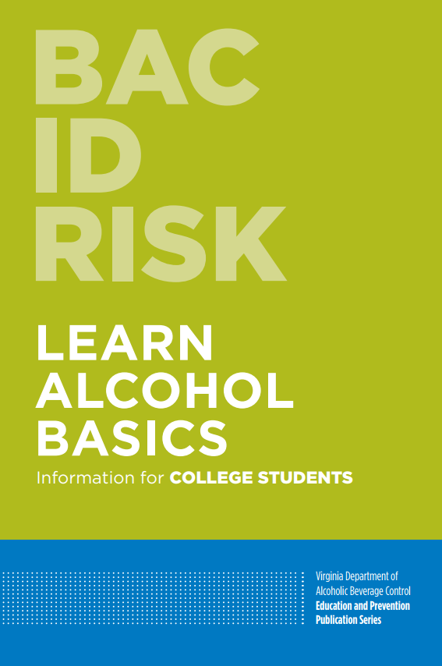
Buzzkill
(2016)
Client:
Virginia Dept. of Alcohol Beverage Control
Campaign Goal:
Provide information to college students on topics such as Virginia law, standard drink sizes, and signs of alcohol poisoning
Research
Informed by secondary research that shows incorporating law enforcement interventions into programs in colleges has significant benefits. (Source: NIAAA and US Dept. of Education)
Key Message:
Mostly facts and information, no overarching message
Channels:
Downloadable 24-page booklet
Twitter - @PartySafeVA
Creative Approach:
Infographics, visually catchy design and text treatments
Results:
The campaign on college campuses has led to significant reductions of BAC drinking and driving among teens and young adults. (Source: SmartSafeandSober.org)

Slide 9
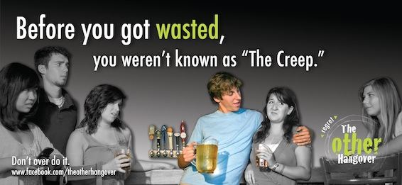
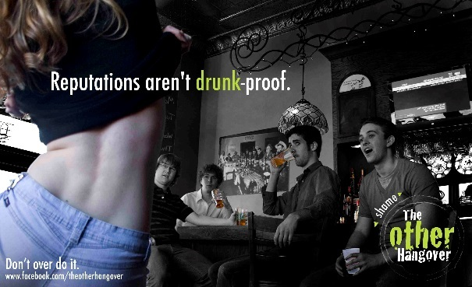
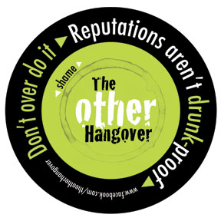
The Other Hangover
(2011)
Client:
University of Minnesota-Twin Cities
Campaign Goal:
Decrease binge drinking in college students by increasing awareness of negative social and reputational effects of overconsumption
Research:
Primary research identified five “Triggers” for why students over-consume alcohol: “social lubricant,” “college syndrome,” “clocking out,” “competitive spirit,” and “bargain boozing.” (Source: campaign evaluation report)
Key Message:
Binge drinking has many consequences, including harming your reputation
Channels:
Out-of-home, print, and promotional materials
Social media
Creative Approach:
Grounded in research with students, which showed that a majority agreed that binge drinking could result in regrettable, reputation-harming behavior
Results and Miscellaneous :
Finalist campaign in AAF’s National Student Advertising Competition
Based on post-campaign surveys, resonated more with college students that other responsibility campaigns
72.9% unprompted recall during height of campaign activity; 86% recalled the campaign logo; 54.8% of all students reported discussing the campaign with friends. (Source: campaign evaluation report)
Success led to its expansion to three other schools in Minnesota

Slide 10
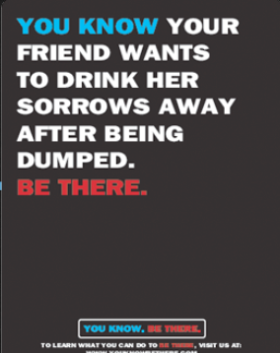
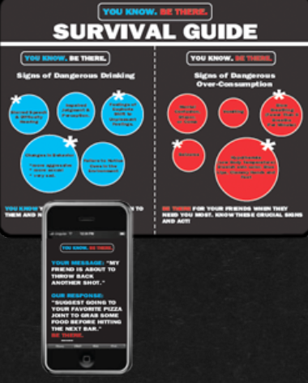
You Know. Be There.
(2014)
Client:
George Washington University
Campaign Goal:
Prevent overconsumption of alcohol by raising awareness of its signs and symptoms
Research:
Student research confirmed that “preachy” messaging is a turn off, and that students recognize signs of overconsumption and want to help friends, but don’t know how. (Source: GWU)
Key Message:
Be there for your friends by helping them out when they’ve drank too much
Channels:
Posters
Mobile ads
Creative Approach:
Uses a simple, minimal approach with dark colors and straightforward messaging
Results:
Finalist campaign in AAF’s National Student Advertising Competition
Surveys following the campaign showed positive results. 60% of freshmen were aware of campaign, 93% of those knew it promoted safer drinking; nearly 50% reported intervening to help a friend who drank too much

Slide 11
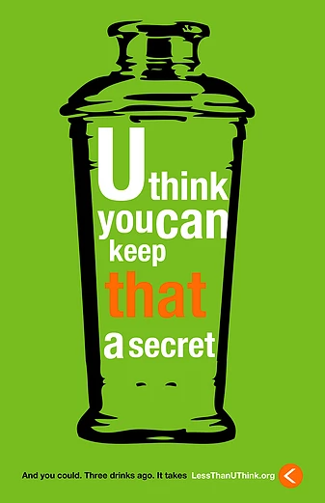
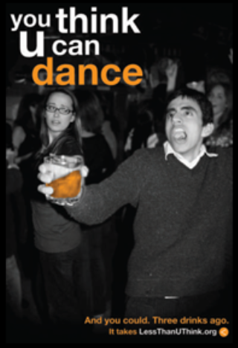
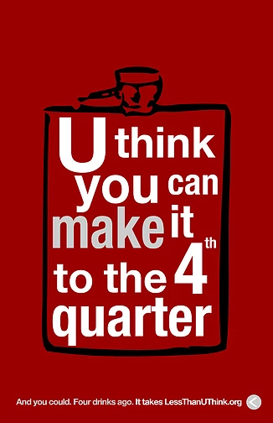
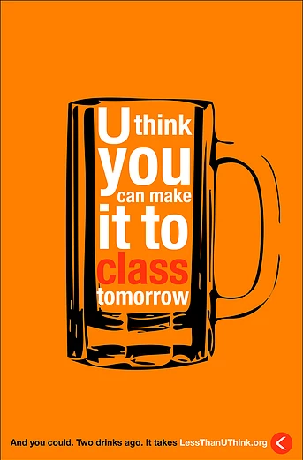
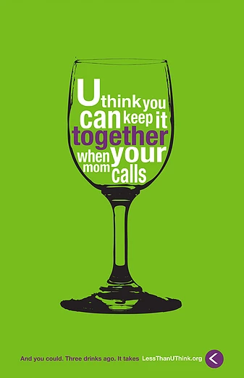
Less Than U Think
(2010)
Client:
The University of Alabama
Campaign Goal:
Raise awareness of the physical and social consequences of binge drinking
Research:
Formative and evaluative research conducted by The Century Council, which found that the term “binge drinking” is not relevant to college students, embarrassing behavior is indicative of a great night out, and peer-based messaging only works its actually about a student’s own peers, among others (Source: “Communication Strategies for College Binge Drinking Prevention” presentation)
Key Message:
Drinking too much may limit your ability to do the things you want to do
Channels:
Website
Posters
T-shirts
Social media
Creative Approach:
Messaging takes away the glamor and coolness of drinking
Miscellaneous:
Finalist campaign in AAF’s National Student Advertising Competition
Campaign is entirely student-created and run
Versions of campaigns have been implemented at other universities

Slide 12
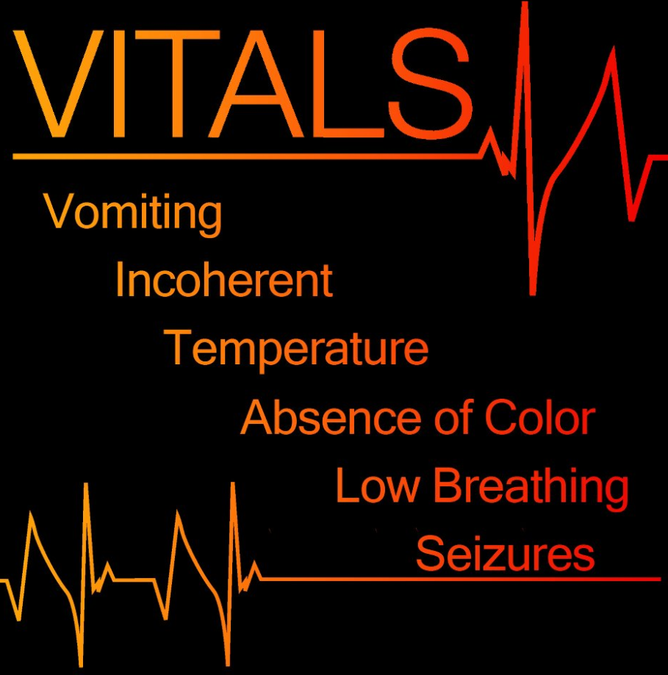
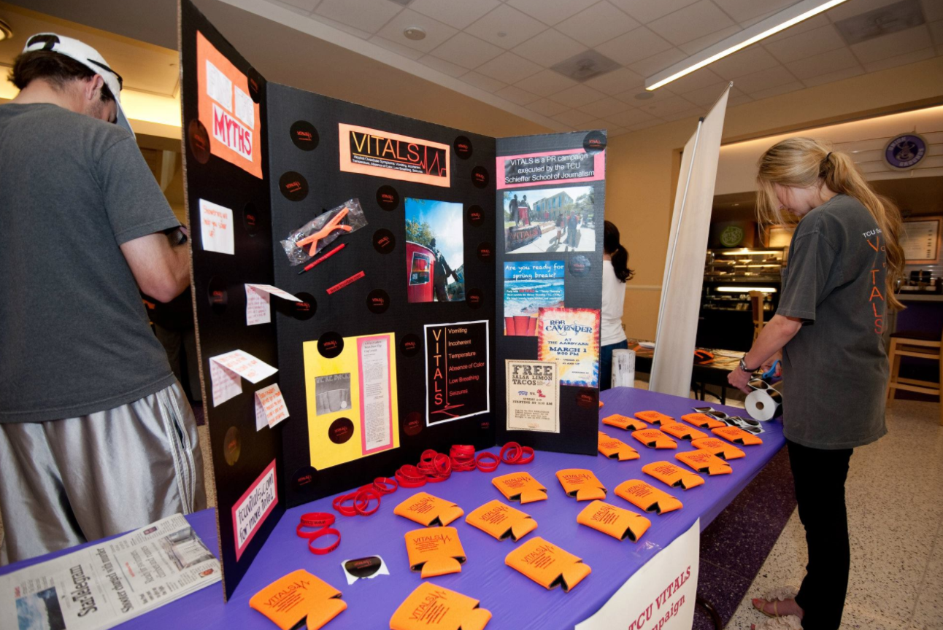
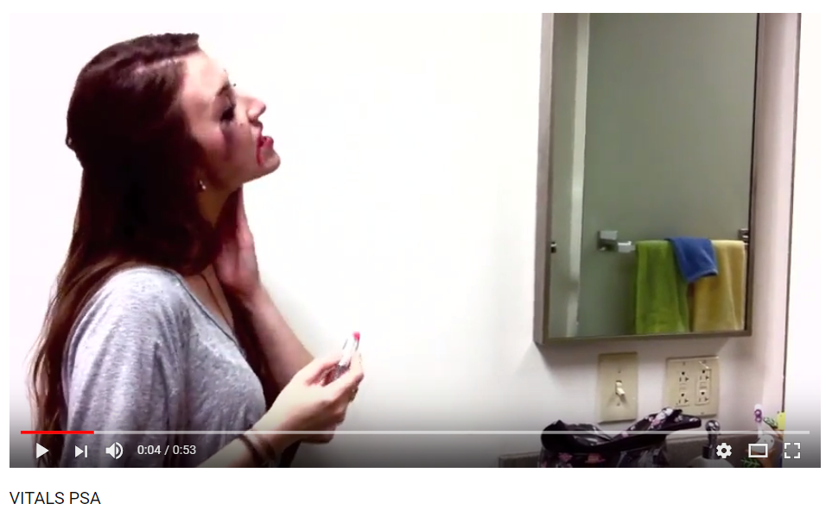
VITALS (2011)
Client:
Texas Christian University
Campaign Goal:
Raise awareness of signs of alcohol poisoning
Research:
TCU survey showed 33% of students said they or friends experienced alcohol poisoning
Key Message:
Know the signs of alcohol poisoning
There are legal, physical, health and social consequences to excessive drinking.
Channels:
Website (no longer active)
Posters
Social media, video
Can cozies
Creative Approach:
Eye catching, bright, edgy
Results and Miscellaneous:
Finalist campaign in AAF’s National Student Advertising Competition
VITALS stands for “vomiting, incoherent, temperature, absence of color, low breathing and seizures.”
Evaluative research showed that 89% of students were likely to share what they learned about VITALS with family and friends. (Source: Seasonal Campaign Report, 2012)

Slide 13
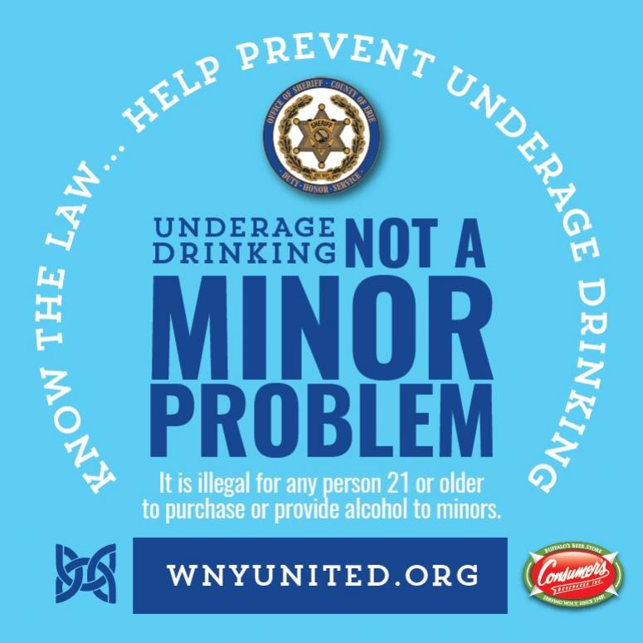
Underage Drinking: Not a Minor Problem- College Edition
(2007)
Client:
New York State Office of Alcoholism and Substance Abuse Services
Campaign Goal:
Empower college students to make the decision not to drink by changing community attitudes towards underage drinking
Key Message:
Underage drinking is harmful and illegal until an individual is 21
Channels:
Previews in movie theaters
Print materials distributed to campuses and communities
Creative Approach:
A contest to create a PSA was conducted between Universities in the state with the winner receiving up to $25,000 to develop it
Content was divided between parents, students, communities, and universities
Notes:
Note: Neither formative nor evaluative research was available.

Slide 14
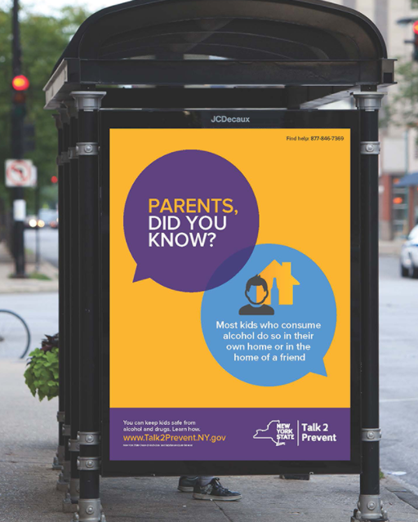
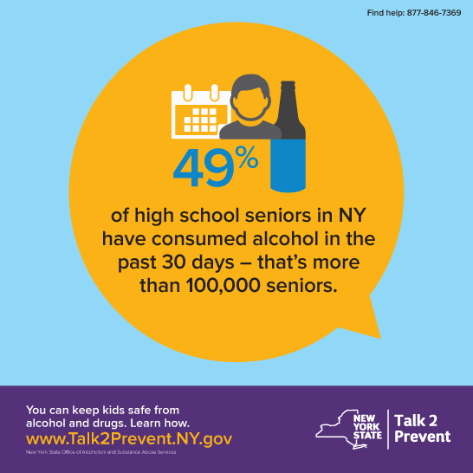
Talk2Prevent
(2016)
Client:
NY State Agency partners – Office of Alcoholism and Substance Abuse Services, Liquor Authority, DMV, Police
Campaign Goal:
Prevent underage drinking, drug use, and addiction on college campuses
Key Message:
Parents can keep kids safe from alcohol and drugs
Channels:
Posters, fact sheets, postcards, kitchen table toolkit, coffee sleeve
Social media assets
Radio PSAs
Creative Approach:
Uses a straightforward tonality
Anything else notable:
NY has not yet implemented a larger outreach campaign to campuses, only developed assets.
Materials are translated in Spanish
Children whose parents talk with them regularly about underage drinking risks are 42% less likely to drink alcohol. (Source: NYSOASAS)
Notes:
Note: While formative research is included in this slide, no evaluative research was available.

Slide 15
Adjacent Issues

Slide 16
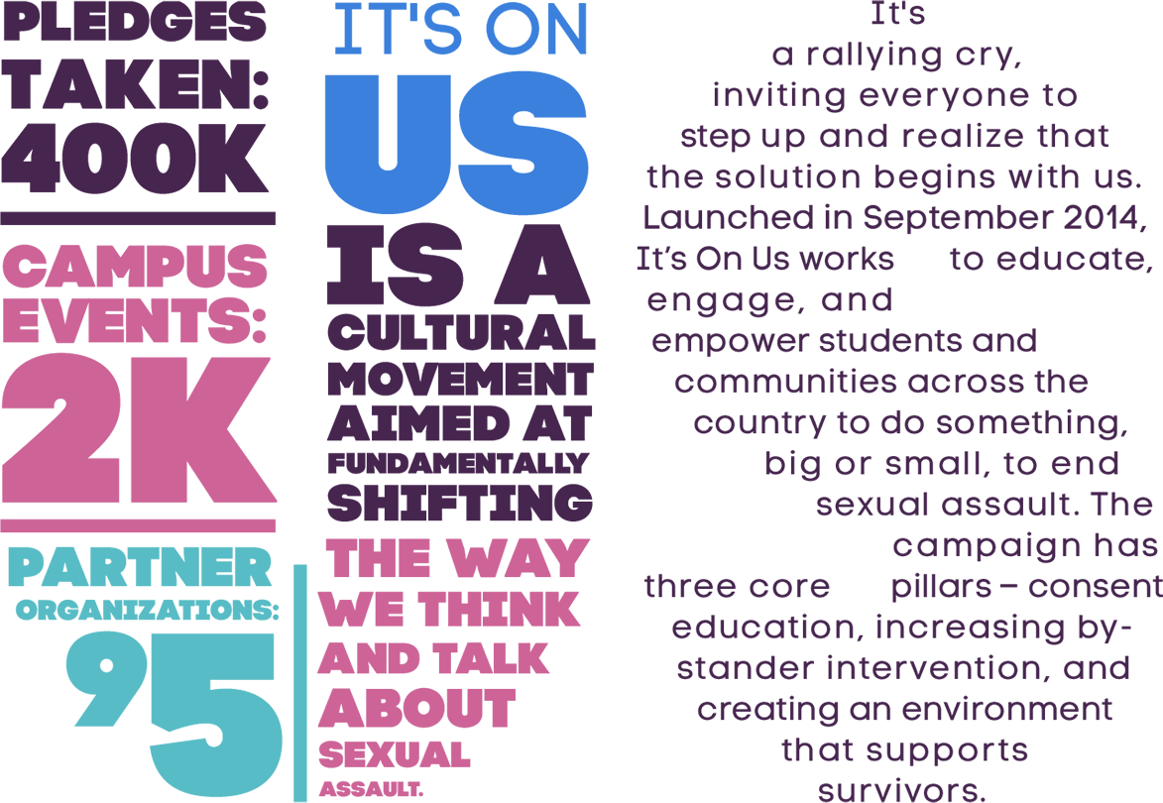
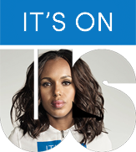
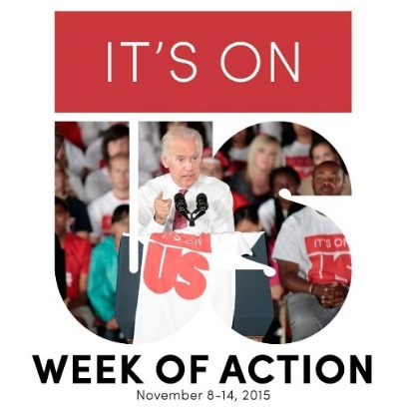
It’s on Us
(2014)
Client:
Civic Nation, The Ad Council
Campaign Goal:
Reframe the conversation about sexual assault to give responsibility to enablers, especially on college campuses
Key Message:
We have a responsibility and the power to stand up against sexual assault
Channels:
Traditional and non-traditional advertising methods
Creative Approach:
Campaign accredits timing and the increase in sexual assault coverage in news and pop culture with its success
Results:
Arguably the most successful social awareness campaign in history. Campaign was launched by 300+ schools, hosted 650+ events, over 220,000 took a pledge to end sexual assault on college campuses, and PSA viewed over 10 million times, generating 3 billion media impressions. (Source: The White House)
Successfully changed the conversation about sexual assault at universities
Notes:
Note: While evaluative research is included in this slide, no formative research was available.

Slide 17
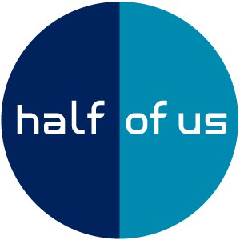
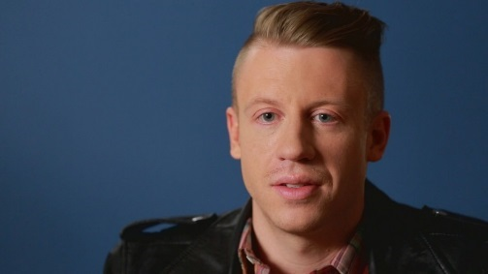
Half of Us
(2006)
Client:
MTV U
JED Foundation
Campaign Goal:
Show young adults struggling with mental health that they are not alone, and encourage them to seek help
Research:
Primary research showed emotional preparedness is a major factor to students’ success during 1st year of college. (Source: The Harris Poll)
Over 51% of students found it hard to get emotional support at college; if they did, they 76% more likely to turn to friends than to university staff (24%). (Source: The Harris Poll)
Key Message:
You have the power to help yourself or someone you know who is struggling
Channels:
On-air programming on MTV
An interactive website and social media pages
Creative Approach:
Used celebrities to share personal stories of struggles with mental health and drug issues
Results:
Received minimal attention outside of MTV, but receives extensive reach through the TV network and its other platforms

